Slide 1

Sohar International: BI, Advanced Analytics and DWH
LatentView RFP Response Presentation to Sohar International Leadership
23 - July - 2020

Slide 2
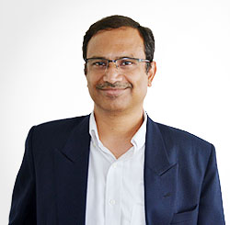




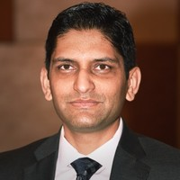




Who’s here from LatentView today
Rajan Sethuraman
Krishnan Venkata
Shalabh
Chief Executive Officer
Chief Client Officer
Chief Growth Officer
Karthikeyan Sankaran
Gopal Appuswami
Paresh Chiney
Prowino Paiva
Business Head – BFSI
Delivery Head - BFSI
Client Partner - BFSI
Program Manager - BFSI
Karthick Hariharan
Anup Gunaseelan
Siva Shankar
Chief Architect, Data Engineering and Services
Head of Knowledge Management
Head of Demand Generation

Slide 3



Executive Summary
Sohar International is an international bank that aims to help its customers 'win'​ by delivering responsive banking for their ever-changing world. In an increasingly digital and remote world, BI, Data Analytics and AI/ML are powerful tools that can help accelerate this transformation.
01
Sohar International is running a strategic initiative aimed at transforming its BI and Data Analytics capabilities and is looking for strategic long-term partner that can balance their short-term priorities with the long-term vision.
02
Through this response, we hope to
Have a better understanding of Sohar International's landscape through a dialogue
Help you understand how and why transformational analytics initiatives succeed
Learn enough about each other to assess if we are a good fit to partner
03

Slide 4
Agenda
1
Introduction to LatentView Analytics
2
LatentView’s Understanding of the Scope of RFP
3
Proposed Approach and Methodology
4
Our Experience in DWH, Reports & Dashboards, Analytics
5
Demos in Reports and Dashboards
6
Our Data Warehousing and Data Engineering Process
7
Representative Case Studies in Advanced Analytics

Slide 5
Introduction to LatentView Analytics

Slide 6




LatentView Analytics is a recognized leader in Analytics and Insights
Over
700
People strong
Work with
30+
Fortune 500
firms
Rated as Top Analytics firm rated by Frost and Sullivan
In 5 out of 7 sectors, we work with Industry Leaders
Founded in
2006
Develop Solutions for 4 of the Top 5 Tech companies
Only company recognized 9 consecutive times in Deloitte Technology Fast 50
>85% Repeat business
Awards & Recognition
AI Award Winner 2018
Winner at 2017 Netherlands Conference
2009-2017
Member of Technology council

Slide 7






















Trusted Analytics Partner to the World’s Most Recognized Brands
BFSI
CPG
Retail
Hi-Tech
Industrials

Slide 8
Five principles we follow that drive successful engagements
Client Context: Every Client and their situation is unique
Adoption is the Northstar for success
Engaging as a Trusted Analytics Partner
For a Leading Home Appliances manufacturer, while our solution was well received by 2,500 users, we continued to innovate to build IRA when usage starting falling
Balance the short-term considerations with the long-term vision. E.g: BI Transformation that we championed at Sony Pictures
For a Leading Asset Management firm, built a scalable Data Platform from scratch to track Business Performance
Business-led Insights
Cross-pollinating Ideas
For a Leading Computer Hardware manufacturer, our key differentiator was that we didn’t just execute blindly. We tried understanding what the context was and tailor solutions to the needs
Fostering ideas through cross-pollination through Roundtable, Idea Harvesting sessions, Cross-Industry Hackathons has helped us drive innovative solutions for clients. E.g. Panel Miner, SmartInsights

Slide 9
Focussed on delivering Business Benefits to our Clients
Europe-based Iconic Automobile Manufacturer
A Global Technology Devices & Software Firm
Predicting vehicle risks across 108 countries by modeling driver behavior using sensor data
Improving ROI on Marketing spends of USD 1.6 Billion through Purchase Intent Modeling
AI Award Winner 2018
Winner at 2017 Netherlands Conference
Leading Asset Management Firm
Enterprise Data Hub to aid data-driven decision making through self-service BI, Reports, Insights, and Analytics
Leading Online Payments Company
Leading US Based Beverages & Snack Manufacturer
Personalizing campaigns across consumer life cycle through proprietary LVM platform
Predicting consumer trends and preferences using machine learning
Largest Home Appliances Manufacturer in US
Enabling Product innovation through voice of customer

Slide 10







Fostering an ecosystem to cross-pollinate ideas across our clientele
Academia
Advisory Council
Prahalad
Thota
Jaganathan
Jeyapaul
Zoher
Karu
Sr. Vice President, Head of Analytics, Wells Fargo
Vice President of Engineering, Oracle
MD, Head of Data and Analytics, Citi
Hackathons
Cross-Knowledge Sharing
Roundtable, CXO Breakfast/Lunch Series, Webinars
Thought Leadership Forums
Competitions

Slide 11
3P framework to attract and retain employees
Platform
Prepare
Propel
Fortune 500 clients
Cutting edge Analytics
Bright minds from the best colleges
Entrepreneurial approach to problem solving
3-tier learning architecture
Future relevant skill building
Blend with industry and functional expertise for L&D
Core analytics and consulting skill as specialist tracks
Career tracks aligned with industry and domain
Industry relevant rewards
Open and trusting environment
Opportunity to exhibit leadership skill at all level
Flat and Open Culture
Challenging Environment
Encouraging Leadership
Exciting Work
Entrepreneurial Spirit

Slide 12
Onboard & Empower every employee at LatentView
Onboard
12-week analytics boot camp
Capstone project
Real-time business case studies
LatentView L&D Program
Self-learning courses from Simplilearn and Great Learning
Learn
Curated online courses and certification
Trainer led programs with KREA and Edureka
Develop
Skill Dossier
Peer Learning Webinars
Kaggle and KDD to practice learnings
1 in 3 Employees at LatentView have a business degree

Slide 13
How does LatentView Approach Client Engagements?

Slide 14
How does LatentView Approach Client Engagements?
Typical Approach
LatentView Approach
Bias of Domain Knowledge: Fitting a Square Peg to a Round Hole
Over reliance on Domain Knowledge leads to Rigidity in Approach
We believe that every organization is unique, our customer knows their business best and service provider's understanding of fundamental principles in the domain can get the best of both worlds to build a robust solution.
Technology is an Enabler, not an End in Itself
Too much focus on technology and tools rather than data & numbers that make up the platform
Reconciliation of data across source and EDW is pivotal in to building a trustworthy platform. Knowledge gained by experience in building analytics solutions for multinational companies
User centric approach for Architecting a 'Fit for Purpose' EDW
Over emphasis on the best of breed technology components could lead to an over-engineered solution
We take a workload centric approach that utilizes technology components in an optimal fashion to provide the best possible user experience
Testing & Quality Assurance as a First-Class Citizen
Testing & Quality Assurance is underestimated and typically undercut on aggressive timelines
Robust Testing & Quality Assurance mechanism so that the system is built right the first time and can accommodate changes gracefully
Business has a bigger role to play than just sign-off
Treating transformation as an IT initiative which alienates the business stakeholders, with their involvement restricted to UAT and sign-off
In our experience, bringing Business & IT teams together through every milestone of execution of the project helps get timely business inputs that has better chance of end-solution being adopted and accepted better

Slide 15
Leading Asset Management Firm: Context and Challenges
Business Context
Second oldest member in the TAMP industry
~$50Bn in assets value
8000+ financial advisors all over U.S.
Our Client has embarked on a digital transformation journey and started collecting huge amounts of data, but the challenge was that, business didn’t leverage this for decision-making.
Client CIO Commitment
Vision: To build Best in class data and analytics platform for TAMP industry
Culture: The team should think about what they can do better in every next day using Agile
Operations: Flexible in reaching out to CIO directly if we don’t get required information
Business Challenges
Siloed data known only to the "individual" in the team
Lot of manual activity. A monthly report took 12-14 days to generate
Each department had their own set of people to do reporting (Mostly Excel, PowerPoint)
Accelerated when they got listed and needed 1 team to go own the data
Azure subscribed - What do we need, how should we work it through
IT Vendor with a 400+ team couldn't take it forward (supporting Production applications, contact center)
Notes:
Our Solution: 0. First for us in the TAMP Industry - Individuals had expertise, but as a project this was first 3 year 1. Detailed Implementation plan (No onsite - realized 3 months later that there is a need for it) 2. Sessions with specific team members from AssetMark to go over elements of the report (spent about 3-4 weeks). 3. Deciphering relevant data with their data teams that deal with specific applications. 4. Carved out a What we've delivered 1. 4 pages of the F (Solutions & Strategy Team) Fun-facts - AUM - Insights 2. SOX compliance 3. Lead Scoring (Analytics) 4. 10 years worth Historical data

Slide 16










Envisioned and developed the Enterprise Data Hub
Enterprise Data Hub (EDH) – is a data platform built on Cloud (Azure), the data from disparate sources are physically migrated from the source format into Azure Data Lake. The primary goal of EDH is to be the single version of truth for the Organization and aid data-driven decision making through self service BI, Reports, Insights, and Analytical solutions.
Data Sources available in EDH
350 GB
Daily Volume of data processed
10 Years
Data Availability
Adobe Analytics
Off-platform files
The planned RoadMap
Data Platform
Decision Boards
Advanced Analytics
(AI & ML)
Adoption
Goal 1
Goal 2
Goal 3
Goal 4
Strategic Goals
Build Enterprise level Data Platform
Quick Decision Making
Insights from the Existing Processes
Drive business adoption
Data & Analytics
Objectives
Cloud enabled & Scalable Data Architecture
Faster Generation of Business Insights
Use Case Formulation
Experiment & Learn applying ML & AI
Utilize Machine Learning & AI
Analytical Platform Initiatives
Data Infrastructure Enhancements
Discovery of new functional use cases
Run Analytics POCs
(Experiment & Learn)
Deploy and
Scale the POC
Improve process efficiency

Slide 17
The EDH foundation helps drive actionable insights
Adobe Analytics
Off-platform files
Entity Data & Masters
Financial Advisor Data
Investor & Strategy Data
Customer Relationship Data
Custodial Platform Data
Securities & Holdings Data
Pricing Data
Relationship
223 entities from Salesforces.
Complete relationship data of Advisor-Investor relationship
Behavioral Data
Marketing & Campaigns
Behavioral Data
Investment Portal
Portfolio Data
Wealth Mgmt. Application
Website Data
Digital activities
Third Party Feeds
Transactions Feeds (2)
Data from Applications (6)
Daily Volume Processed
35 GB
Data Available
10 Yrs.
Daily Volume Processed
6 GB
Data Available
10 Yrs.
Daily Volume Processed
1 GB
Data Available
2 Yrs.
Daily Volume Processed
2 GB
Data Available
2 Yrs.
Daily Volume Processed
250 GB
Data Available
10 Yrs.
Pilots to demonstrate Architectural choices (8)
Strategy & Solutions Report (1)
SOX Compliant Data sets (100%)
Lead Scoring Model (1)
10 years of Historical Data

Slide 18













Why a BFSI client continues to engage with LatentView
Variety and Complexity of Solutions
Solutions by Business Unit
Decentralized global engagement model with
colocated teams in individual geographies
Visually reconstructed the payment paths that a user can take through various stages of a checkout to understand customer behavior
Product Analytics
Complex
Marketing Analytics
A single view of campaign performance aggregated at a across geographies that can be drilled further into programs, channels, campaigns according to user role
Medium
Visualize gap between expected revenue and actuals using funnel and waterfall views to identify leakage segments
Complexity
Financial Planning
EMEA
Web Analytics
Customer acquisition and activation journey from TOF to Conversion visualized through Tableau funnel dashboards
LATAM
LATAM
LATAM
Simple
APAC
APAC
APAC
APAC
APAC
Fishbone visualization providing conversion delta between test and control groups for daily use by business teams to tune web experiment performance
North America
North America
North America
North America
North America
North America
Experiment ation
2014
2015
2016
2017
Teams we work with
Product Analytics
Marketing Analytics
Business Analytics
Website Analytics
Pricing Analytics
Global Financial Services
Research Team
Risk Analytics
Finance

Slide 19














Our Decade-Long Journey in BFSI
Diversified, consistent partnership in BFSI, delivering customized solutions to satisfy business appetite
| Fraud Detection |
2013
| Order to Cash |
2018
| Credit Risk Scoring |
2012
| Ad Performance Analysis |
2018
| Analytics CoE|
2019
| Data Management |
| Visualization |
2011
| AR Forecasting |
Predict Delayed Payments |
| Credit Risk Profiling |
2017
2019
| E2E Data and
Analytics|
2008
Now
2008
| Layout Optimization |
(for Promotions)
2015
| Transaction Analysis |
| Agent Performance |
2009
| Product Affinity Analysis |
2016
| CRM | Marketing |
| Finance |
2010
| Marketing | Product | Research |
| HR | Pricing | Finance | Risk |
2017
| Analytics CoE|

Slide 20
Discussion around Business Imperative

Slide 21
Discussion around Business Imperative
1
2
How does business make decisions currently in the absence of DWH infrastructure?
How are MIS reports/dashboards currently delivered and consumed by users?
How does these aid in making decision-making?
3
4
What are some of the use-cases at Sohar International from Wholesale / Retail / Islamic / Digital Banking where Analytics can help solve the business problems?
What does business success look like – 1 year and 3 years?
What has been the past success / learnings through DW and analytics initiatives

Slide 22
LatentView’s Understanding of the Scope of RFP

Slide 23
Sohar Bank DWH, BI & Analytics RFP – Context & Objective
Business Context
Sohar International currently uses produces MIS reports manually. 80% of the data are stored in Oracle and 20% in Microsoft
Sohar International currently does not have any BI / DW and Analytics platform including ETL , Data Store, Data Modeling
Sohar International has 2.5 – 3 TB of data for all Production systems and anticipates at least 5 TB of additional data in next 2-3 years
Sohar International has nearly 45+ production sources. Each Production Database has minimum 1000+ tables. Core Banking alone has 15000+ tables & views. Islamic Core banking alone has around 11000+ tables. ERP has around 12000+ tables
Business Objectives
1
2
3
4
5
Building Enterprise Data Warehouse
Automation of MIS Reports
CXO Dashboards
Self-Service BI Platform
Advanced Analytics
Study the current MIS reports, business requirements, AS-IS system
Propose the To-Be system and implement end-to-end DWH solution
Identify reports for automation
Clean the raw data and feed into the database. Define the KPIs and streamline the MIS reports
Identify dashboarding requirements from Executives
Define KPIs, implement and iterate for feedback and changes
Enabling self-service BI platform for quick decision-making
Recommending a platform that aligns with the overall system architecture
Understanding the business requirements across Wholesale, Retail, Digital, Islamic Banking
Implement the analytics solution and publish the insights

Slide 24
RFP Scope
Track 1
Providing Thought Leadership and Consultative Engagement across 4 Phases
Design
Build
Sustain
Strategic assessment of existing setup, study existing data, business processes, IT processes, and prepare Gap Analysis etc.
Delivery of Reports, Dashboards, Scorecards as part of Agile sprints. Facilitating Change Management and Reporting & Communication
Creating and delivering Training materials, User manuals, Knowledge Management, Capability Building etc.
Track 2
Phase 1
Phase 2
Phase 3
Phase 4
Discovery (Due-Diligence)
(Initial 6 Weeks in Phase 1)
and
Implementation of MIS Reports Automation
Data, Tools, Tech. Stack
Domain knowledge
Automation of 30 MIS Reports
5 Dashboards (CEO, Wholesale, Retail, Islamic and Digital)
Building DWH
Training & Documentation
Implementation of Additional MIS Reports Automation, Dashboards, Scorecards
Finance Dashboard
Risk Dashboard
Product & Portfolio Dashboard
Remedial & Collections Dashboard
Customer 360 Dashboard
Cust. Exp. Dashboard
Balanced Scorecard
Training & Documentation
Implementation of Additional MIS Reports Automation, Dashboards, Scorecards, Analytics
HR Dashboard
IT Dashboard
PMO Dashboard
Marketing, Operations Dashboard
Updating MIS Reports & previous Dashboards
Customer & Marketing Analytics
Risk and Product Analytics
Predictive Analytics in Finance & HR
Training & Documentation
Implementation of Dashboards, Analytics
Revisiting Scorecards & Dashboards
Predictive and Prescriptive Analytics in
Customer & Marketing
Operations
Finance
Risk
Product
HR
Training & Documentation
LatentView Confidential

Slide 25
LatentView’s Proposed Approach and Methodology

Slide 26
Proposed Implementation Approach and Timelines for Sohar International
LatentView understands that the Bank has proposed the Phase wise approach and the timelines in the RFP. However, given our extensive experience in executing similar large scale and complex programs with other Financial Services clients, we believe the below timeline across the Phases will help achieve the desired outcome within the 28 months program duration.
Training across four phases involved in the engagement
Predictive & Prescriptive Analytics
Go-Live
(6 Months)
Application Support & Maintenance
(ASM: 3 Years)
Advanced Analytics
Descriptive Analytics
Scorecards
Scorecards
Decision Support
Scorecards
Scorecards
Analytics Maturity
Dashboards
Dashboards
Dashboards
Dashboards
Operational Management
MIS Canned & Ad-hoc Reports
MIS Canned & Ad-hoc Reports
MIS Canned & Ad-hoc Reports
MIS Canned & Ad-hoc Reports
Phase 1
Phase 2
Phase 3
Phase 4
Go-Live
ASM
Enterprise Data Warehouse, Reports Automation, Self-Service BI Platform, Advanced Analytics
Indicative Timelines
8 months
8 months
6 months
6 months
6 months
3 Years

Slide 27
Why do we think the proposed timeline is appropriate for this program
Key Objectives for Phase 1:
Ensure Thoroughness & Coverage of Assessment (Discovery & Due-diligence)
Deliver end-to-end work product that can be consumed by Business (full life-cycle)
Engage with Business Users along the journey
Key Considerations for Phase 1:
First time understanding of Systems, Tools, Processes, Stakeholders
Diversity involved in Banking concepts (Wholesale, Retail, Islamic, Digital)
Foundational elements of understanding & analysis of data is more
Requirement-Build-SIT-UAT-Deploy-Train cycle will be experimented end-to-end
Complexity involved in reconciling Source to Target in stage of the warehouse
External dependencies and constraints assessed & mitigated for first time
Possibility of occurrence of teething issues on a new infrastructure
Following an iterative process to design, prototype (wireframe, PoC) and validation from all concerned stakeholders

Slide 28

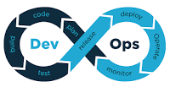
Phase 1: Objectives & Considerations
Key Highlights of the 8 Month Plan:
6 weeks of Discovery & Due diligence
Implementation Plan & Product Backlog,
Data Warehouse Architecture Blueprint
Indicative list of Data Marts with priorities
From the 2nd month onwards
Product Backlog, User Stories & Wireframes
Incremental monthly updates to User Stories and Wire-frames
From 4th month onwards
Software deliverables start for validation
3 Data Marts related to 2 Dashboards and 2 Scorecards
25 MIS Reports automated (Monthly cycles)
Monthly Release cycles
Incremental updates to components of Data Warehouse
4-week Agile Test cycles:
SIT & Performance Testing,
UAT and defect fixes,
Training and Production Go-Live,
Post go-live support for 8 weeks in Phase 1
Leveraging Scaled Agile Framework (SAFe) and DevOps Best Practices in this proposed engagement
Legend: B - Baseline; F - Final Version; IC - Incremental Changes; S1-S25 - SIT Cycles; U1-U24 - UAT & Fix Cycles; TG1-TG23 - Training & Go-Live Cycles; W1-W22 - Post Go-live Support; PB1-PB12 - Product Backlog Updates; US1-US25 - User Stories Update; X1-X24 - User Experience & Wireframes

Slide 29

Our Approach for Discovery Exercise
Our suggested approach in BI transformation is to understand the current state, identify changes required, assess feasibility in transforming to the new setup and prioritize the solutions that enable transition to new state
Discover
Assess
Prioritize
Understand the business context and current ecosystem
Stakeholder assessment:
identify the stated & unstated needs
Current challenges faced
Identify & propose changes to enable BI transformation
Assess the feasibility of transforming to the new state
Assess the gaps in data availability, tools capability and adoption practices
Define a prioritization framework to evaluate the proposed changes
Draw up a roadmap for addressing gaps and implementation
Notes:
The exercises follow DAP fully or in parts. Sometimes we do only the D and sometimes A &P.

Slide 30
Conceptual data workflow to deliver reporting & analytics
Measure
SLA
Run Time
Failures
Quality
Orchestration using Informatica PowerCenter (Leveraging Push Down)
Visualization
Tool
Raw Data Landing Zone
Processed Zone
Analytics Ready Data Marts
Risk
Wealth
Data Bridge for Analysis
Self Service Platform
Finance
…
1. DBFS Mounted
Raw Files loaded in parts for enabling parallel load
2. Isolated Database
Parallel Processing
KPI Computation & Delta Load
3. Isolated Databases - Load By Business Function
Parallel Processing, Compressed, Partitioned
Data Cubes for End user consumption
Advanced Analytics Workbench
Data Quality Summary
Data Model Registry
Data Usability Measure
Track data quality in 5 dimensions to report on downstream usability
Reference Schema
Data Model using Erwin
Track & Maintain Version

Slide 31
Proposed End to End Analytics Ecosystem
Proposed End to end analytics ecosystem architecture depicts our approach
G. Data Governance
A. Production
B. Replication
Data Catalog
Data Quality
C. Orchestration VMs
Core Banking
Core Banking
VPN Server
E. Oracle Exadata: Dev & Test Environment
Visualization Tool
Islamic Banking
Landing Zone
Processed Zone
Analytics Ready Data Marts
Islamic Banking
BI Server
ACL & Active Directory Integration
Self Service Platform
Ingestion Prod Server
Synced on need basis
Retail Banking
Retail Banking
Dev & Test
Server
Landing Zone
Processed Zone
Analytics Ready Data Marts
H. Access & Security
Advanced Analytics Workbench
Other Sources…
Other Sources…
F. Oracle Exadata: Prod Environment
Exadata 1/8th Rack
I. Analytics Consumption
Code Server
JIRA Server
CI/CD Server
D. Project Management VMs
Virtual Private Network

Slide 32
Enabling Adoption using our Customized Training Touchpoints
Indicative Roles at Sohar
Discovery, Project Execution of Track 2 – Phase 1
Bank Executives
Detailed Training of New Product Features
SOP/User Manual Docs
UAT
User Stories Acceptance
Bank Ops.
End-Users
Deploy & Go-live Support
BAU Operation
Detailed Workshops
Study MIS Reports, Data Sources,
KPI Metrics Definitions, As-Is System
Bank Ops. Champions
Develop Training Materials
Implementation using Agile
Training material updated, shared and iterate
Discovery
Business Requirements Gathering
SIT
Sanity
Test
Data/Analytics Staffs
Design
Proposed To-Be System
IT Staffs
Track 2 - Phase 1
Training Phases
Product Familiarization
Comprehensive Training Program
User Acceptance Test – UAT Training Program
End-User Training Program
Transition

Slide 33
LatentView’s Experience in DWH, Reports & Dashboards, and Analytics

Slide 34
Our Experience in DWH, Reports & Dashboards, and Analytics
LatentView’s End-to-End experience in building a data mart, descriptive, predictive and prescriptive analytics use-cases for a Leading Media Company in U.S.
Descriptive Analytics
What happened?
Diagnostic Analytics
Why did it happen?
Predictive Analytics
What will happen?
Prescriptive Analytics
How can we make it happen?
Data Warehouse
Centralizing & Cleaning Data
Value
Foresight
Building Data Mart and Global Performance Measurement Dashboard for CFO
Insight
Data Driven Approach to Selecting Movie Creatives
Predicting Home Entertainment Revenue using Machine Learning
Hindsight
Complexity

Slide 35











Business Context
Business Context & Roadmap
Provide an actionable reporting framework to be used by the CFO office & other business users to manage and tackle an yearly budget of $750M
Data understanding & KPI Identification
Business Challenges
Business teams were relying on traditional print-outs for the meetings, this resulted in slow response time to requests
Flexible Data Pipelines
There was non-availability of analytical framework to manage budget, revenue for informed decisions. There was no one stop solution and client was running adhoc analyses for insights
Inability to drill down (macro to micro level) on the performance metrics
Iterative wireframe design
Lack of mechanism to pose the right questions about unmet targets, comparative market performance, ability to implement across markets etc.
LatentView consulted with the client stakeholders to streamline the data reporting structure and ensure quick analysis and insights to business users rather than running analyses on demand as and when requested by finance teams
Dashboard Development
User Adoption & Change management
Goal

Slide 36




0
LatentView’s Iterative Visualization Roadmap
Business Context & Roadmap
Business Understanding
Technical Strategy
Data Pipeline
Business requirements document
Technical Design Document
Data understanding & KPI Identification
Agile Framework
Evaluate Wireframes & Enhance
Implement
metric changes in
calculations
Tableau Dashboard Development
Test & Deploy
Flexible Data Pipelines
Change Management
Iterative wireframe design
1
2
3
Dashboard Development
Delivery of Executive view and aggregate regions views
Delivering Title based views across different channels
Increase grain of analysis to include channel level performance at Title * Geography
User Adoption & Change management
Each represents a sprint and deliverable
Goal

Slide 37







Business Context & Roadmap
Data Sources
Data
understanding &
KPI Identification
Finance Data for Budget
Territory summary
Product categories
Operation models
Category
P&L
Customer
P&L
Title
summary
Key KPIs identified
Flexible Data Pipelines
Process of identifying key KPIs involved understanding the business and the huge amount of data amounting to volumes more than 1TB across the world performance of all current titles, catalog titles and TV shows across 5 years. Following this and key discussions with business users, the key KPIs identified -
Measures
Gross Profit
Gross Profit%
Revenue
Cost of Goods sold
Budget
Forecast
Iterative wireframe design
Dimensions
Geography
Product Category
Business Platform
Time
Media Format
Dashboard Development
Key Issues identified with existing KPIs
Combination of dimensions and measures to measure business performance was chosen on Adhoc basis.
Different business users were using different combinations of dimensions and measures without any standardization
Certain KPIs lacked granularity. Hence Cost of Goods was modified with breakdown of costs – Marketing costs, Product costs, Distribution costs etc.
User Adoption & Change management
Goal

Slide 38
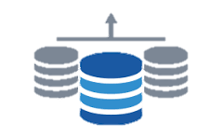



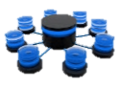






Data Integration Layer
Queries/ Files from Client Teams
Business Context & Roadmap
Finance/ Opex Costs
Category data
Territory data
Data from different Vendors
Integrate the data into one schema from various sources
Text sources are loaded into Teradata
Business, Data understanding and KPI Identification
Business, Data understanding and KPI Identification
Data understanding & KPI Identification
Data marts are built on Teradata DB based on the finalized wireframes
Data Quality/ Governance
Build Tableau dashboards and connect Tableau report to Teradata database
Flexible Data Pipelines
Flexible Data Pipelines
Flexible Data Pipelines
Profiling/Monitoring
Test – QA - Prod
Data Cleaning
The Entire architecture is implemented first in Test environment and replicated in QA and Production environment
Data Consolidation
Iterative wireframe design
Reporting Schema Creation
Data is validated and tested with Business users and feedback is incorporated
Dashboard Development
Tableau Dashboard
Dashboard Development
Dashboard Development
Measure & Compare Performance
Data Mart
Data governance
User Adoption & Change management
User Adoption & Change management
User Adoption & Change management
Feedback
Goal
Business User

Slide 39
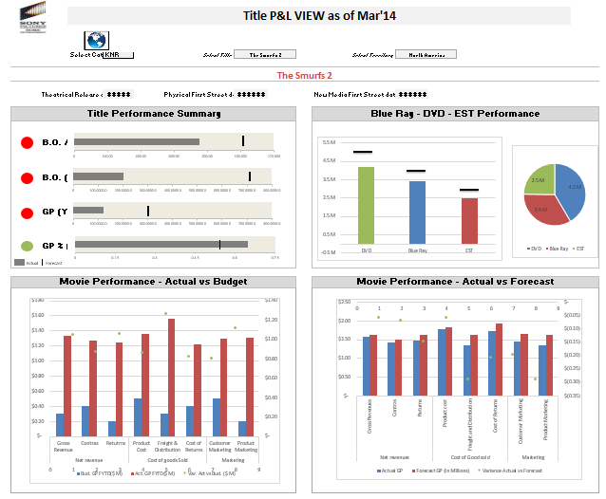
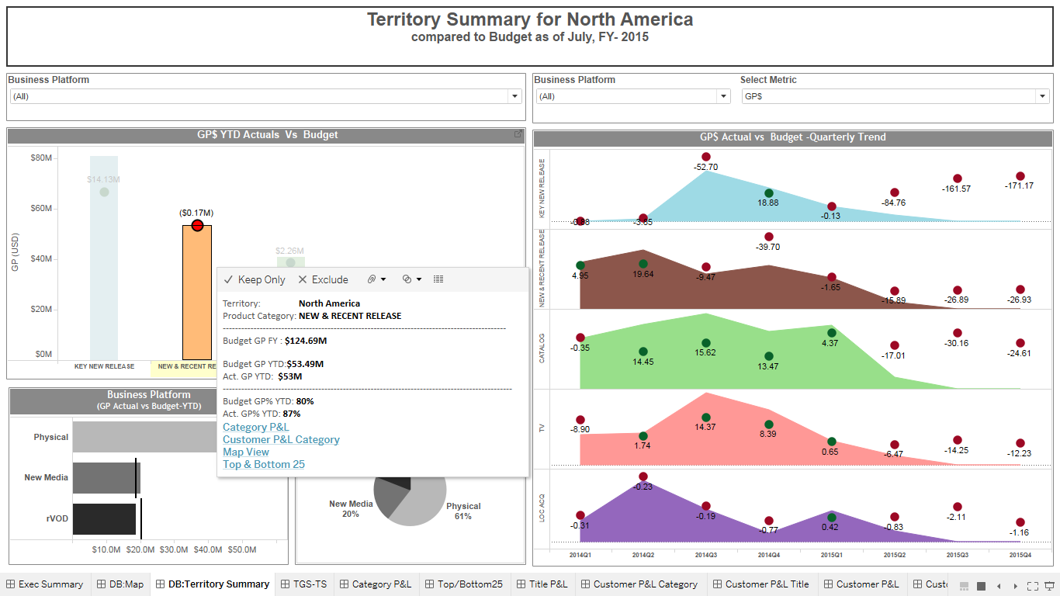
Initial wireframes relied on Filter based approach where filters were needed each time to move to certain sections
Business Context & Roadmap
Initial Wireframes
Final Wireframes
Data understanding & KPI Identification
Flexible Data Pipelines
Flexible Data Pipelines
Iterative wireframe design
Dashboard Development
Dashboard Development
Based on the Feedback, Final Wireframes were build on a more intuitive approach where a business user can start at a macro level (Region level) and drill-down to micro level (Store level) and move back to Macro
Final Wireframes gave insights about the Gross profit trends on a quarterly basis and comparison of Actual vs Budgeted GP.
User Adoption & Change management
User Adoption & Change management
Goal

Slide 40
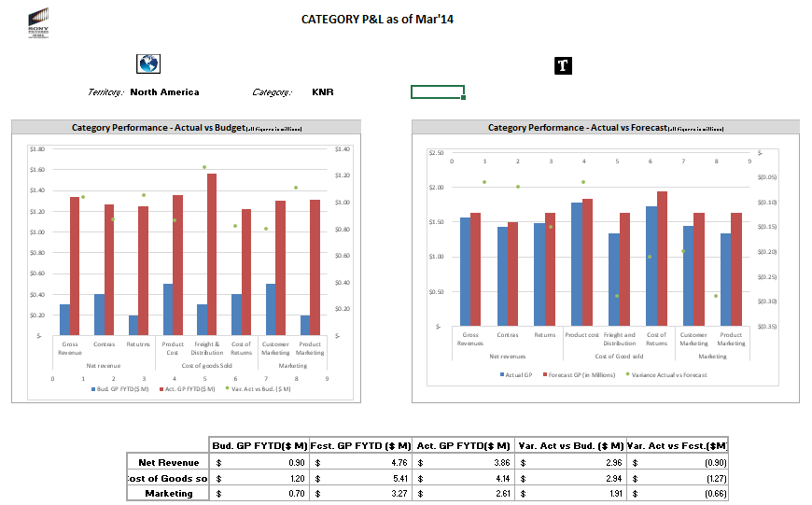
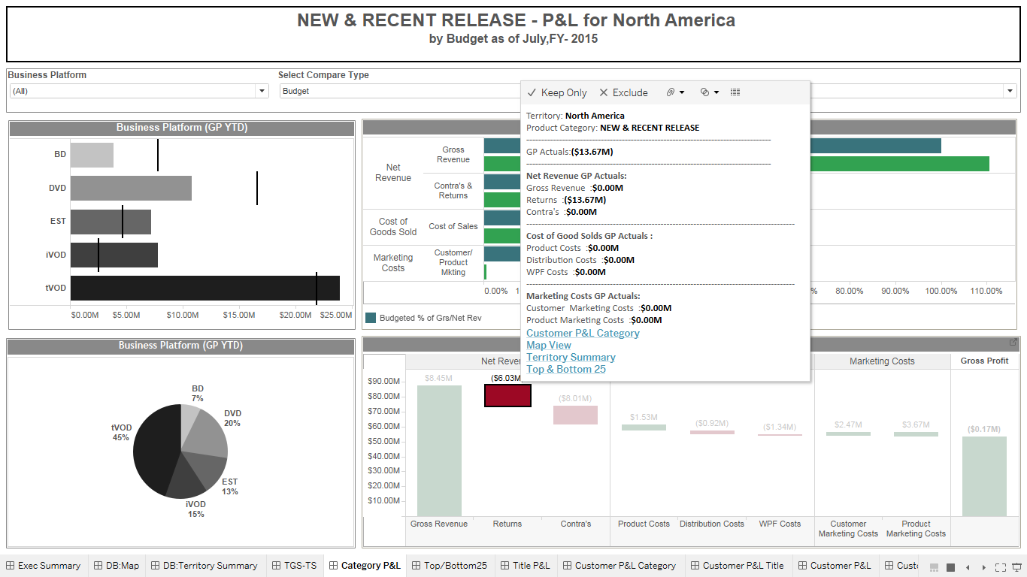
Initial wireframes for Category performances lacked the granularity. It gave break up of Category P&L summary – Revenues, GP etc. at an aggregate level.
Business Context & Roadmap
Initial Wireframes
Final Wireframes
Data understanding & KPI Identification
Flexible Data Pipelines
Flexible Data Pipelines
Iterative wireframe design
After 6 Iterations, Finalized versions of wireframes led to an advanced view which gave granularity with respect to individual contributions of business platforms. It gave a more complete picture.
Dashboard Development
Dashboard Development
User Adoption & Change management
User Adoption & Change management
Goal

Slide 41
Business Context & Roadmap
There were 6 Iterations to design wireframes. In each iteration, wireframe was reviewed with Business and feedback was incorporated
Comparison of key computed metrics with prior reports (KPIs) and Business Sign Off
Data understanding & KPI Identification
Unit and Integration
Testing
Business and Data Understanding
Designing Wireframes
Building Data Pipelines and an ETL Layer
Operationalization Dashboard
Flexible Data Pipelines
Flexible Data Pipelines
1
2
3
4
QC checks
5
6
7
Dashboard design and implementation
Performance Testing
Iterative wireframe design
Multiple Iterations
Working with IT teams to implement extracts, Scheduling
Optimizing the number of data connections, finalizing data sources and building data marts
Dashboard Development
Dashboard Development
Process has to be Re-iterated for multiple Dashboards
User Adoption & Change management
User Adoption & Change management
Goal

Slide 42



Post Dashboard deployment, we worked with stakeholders to get continuous feedback and went through multiple iterations to incorporate feedback/change requests to increase user adoption
Business Context and Roadmap
Data understanding & KPI Identification
Initiatives to increase User Adoption -
User Manual – Creation of user manuals to give end to end business case understanding
Flexible Data Pipelines
Change management – Incorporation of a story telling appeal and simpler to navigate visuals/graphs aided in smooth transition from Excel to Tableau
Iterative wireframe design
Frequency – Daily refresh of dashboards allowed stakeholders to see actionable insights on almost real-time basis
Dashboard Development
User Adoption & Change management
Goal

Slide 43
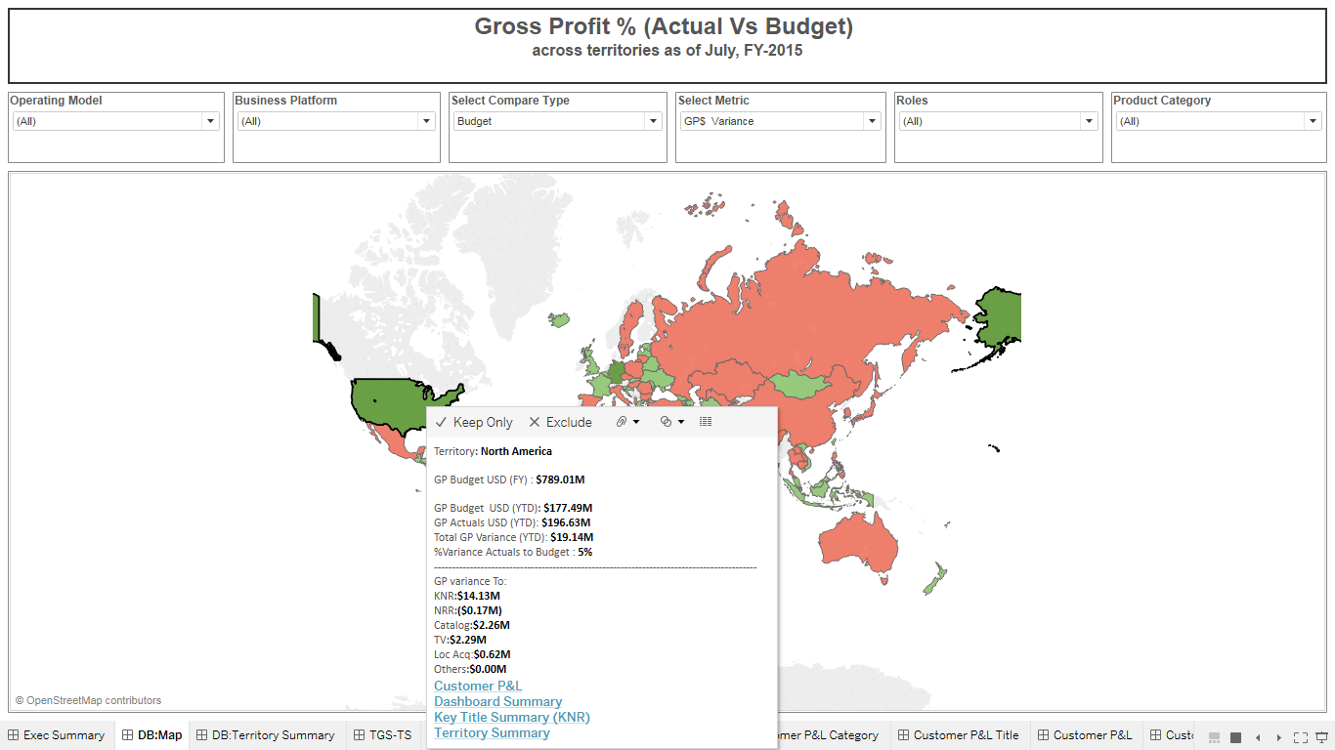
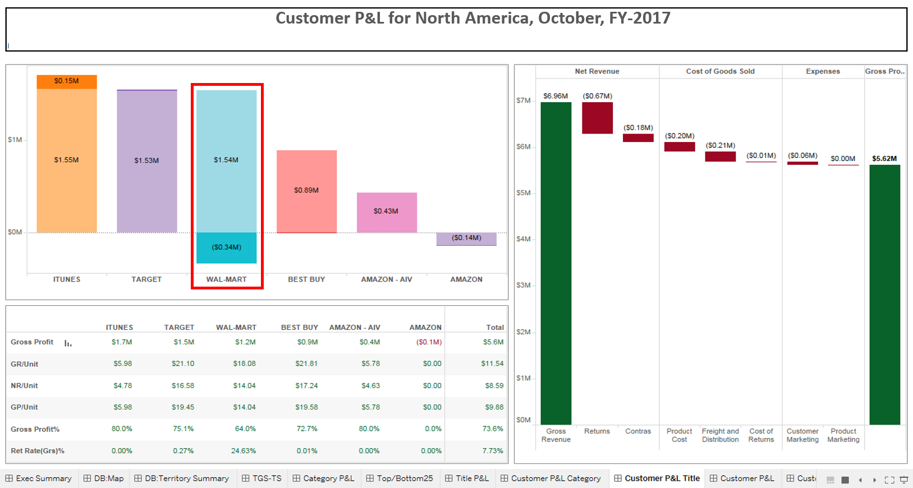
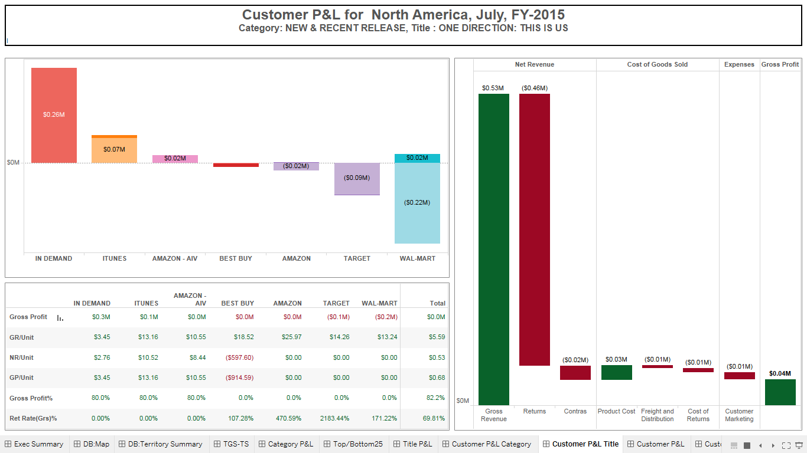
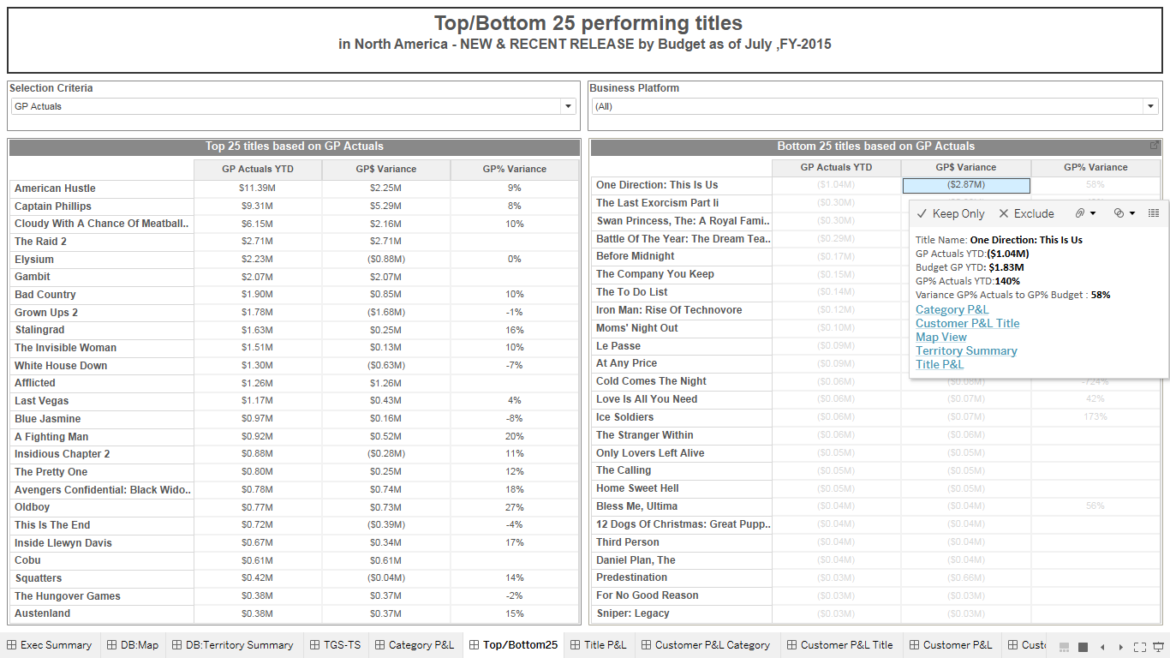

Key Insights from the Dashboard
Drilldown to Customer P&L shows , Walmart returning a major amount of units ordered previously.
Client Management team consulted with Walmart to discuss regarding their Inventory forecast
From the P&L statement on category level, the higher amount of returns might be the reason for the category falling behind compared to the forecast
Drilldown to Top and Bottom 25 titles shows ‘On-Direction: This is us’ is showing negative sales amount.
New and recent releases category couldn’t reach the forecasts
Following the discussion, the returns from Walmart reduced considerably
Use Case: Drill down of North America

Slide 44
LatentView’s Demos in Dashboards

Slide 45
Dashboard Demos
Leading Media Company in U.S.
Leading Electronic Fund Transfer in U.S.
Market Share Analysis Dashboard
Leading Snacks & Beverages Manufacturer
Global Performance Measurement Dashboard for CFO
Built an intuitive, actionable visualization tool that provided insights by categories and geographies
Product Performance Dashboard
Monitoring the performance of fund transfer products across different sectors and geographies
Casper, an AI driven, domain specific assistant with built in capabilities, intelligent analytic suggestions, summarization capability and Continuous improvement
Automated Inventory Diagnostic Tool
Provided a platform for an end to end inventory diagnostic solution illustrating the flow of inventory for both Raw Materials and Finished Goods
Demo
Demo
Demo
Demo
Notes:
https://10ay.online.tableau.com/#/site/itteam/projects/98649
user id: itteam@latentview.com
password: T@blE@ulv2@2@!

Slide 46
LatentView’s Data Warehousing and Data Engineering Process

Slide 47







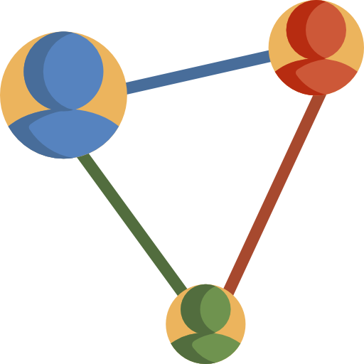
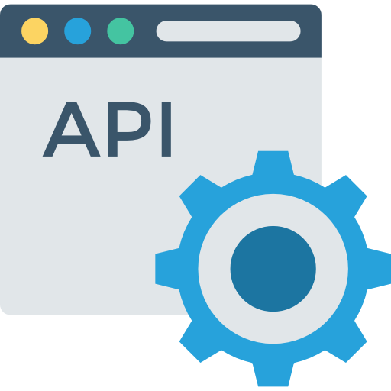









LatentView’s Ideal Data Platform Blueprint
Real Time Streams
Search Engines
Interactions
Operational Analytics
Lookup data stores
External Users
Analytics Ready Data Lake
Business & Technical Catalog
Observations
Enterprise Data As A Service
Transactions
Files
Internal Business Users
Data Warehouse
Batch Transformations
Reporting Trends & Insights
Master & Reference Data
Advanced Analytics Deployments
SOURCE
PROCESS
STORE
SERVE
ACCESS LAYER
Current Focus
Notes:
A scalable data platform has multiple components
Based on the requirements, we would be primarily discussing our processes associated with batch transformations, warehousing & cataloguing in detail

Slide 48
Our approach to engineering data & analytics processes
Maturity Assessment
Data Lineage
Data Dissemination
We assess data platform maturity and recommend initiatives
We track lineage and catalog business/ technical metadata
We build self service platform to export reports and collaborate
Conceptual Data Workflow & Proposed End to End Analytics Ecosystem
System Analysis
Data Modelling
Total Data Quality
We extract & analyze source system schema & configuration
We design data models for enabling business consumption
We assure data accuracy, completeness, timeliness for downstream integration
Process Analysis
Orchestration
Observability
We assess the complexity the business processes
We instrument end to end processes with all dependencies
We provide end to end visibility into operations and ecosystem performance
Ecosystem Understanding
Design & Implementation
Operations & Monitoring
Notes:
We have 3 pillars to help design and implement data & analytics processes
I believe this approach will align well with the two tracks requested for in RFP

Slide 49
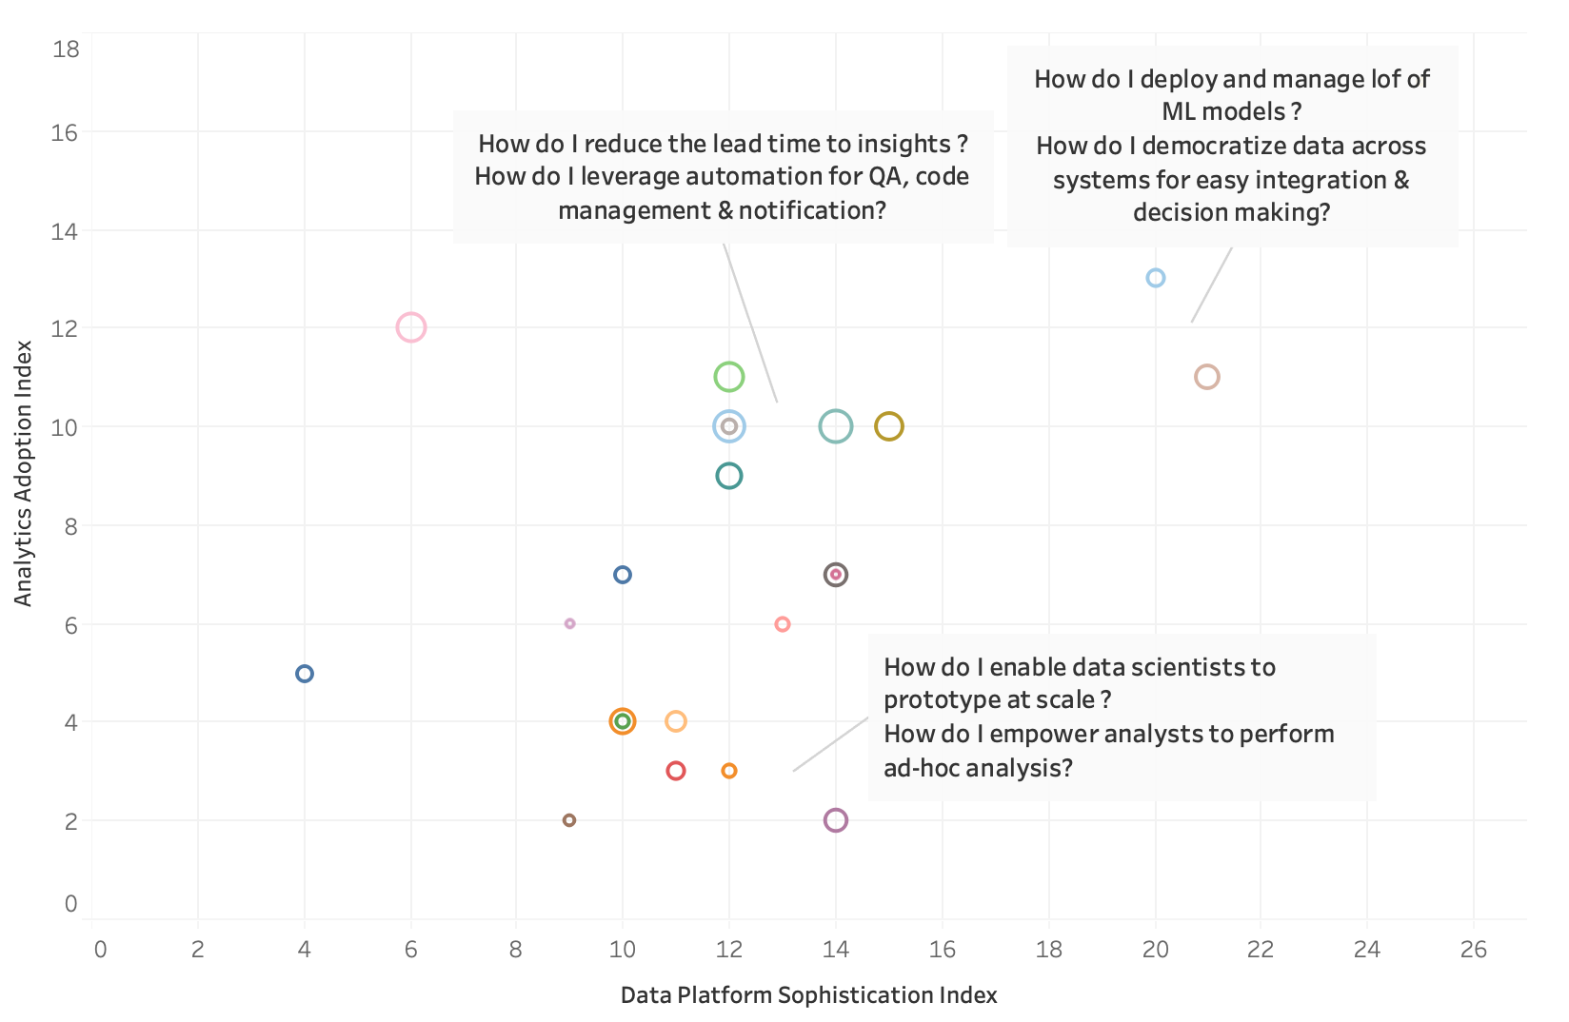
We have an assessment framework to analyze maturity and recommend strategy
Analytics
Adoption
Index
REVOLUTIONARY
LEGACY
PIONEERS
REPORTERS
FOLLOWERS
MOVERS / REBELS
Data Platform Sophistication Index
© LatentView Data Services Assessment Framework, 2019
Survey Results of Top 30 clients of LatentView
Approach Slide

Slide 50
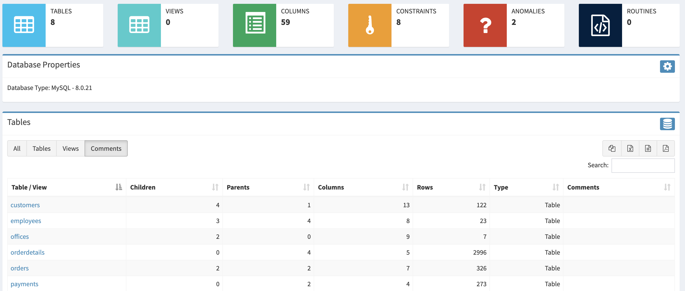
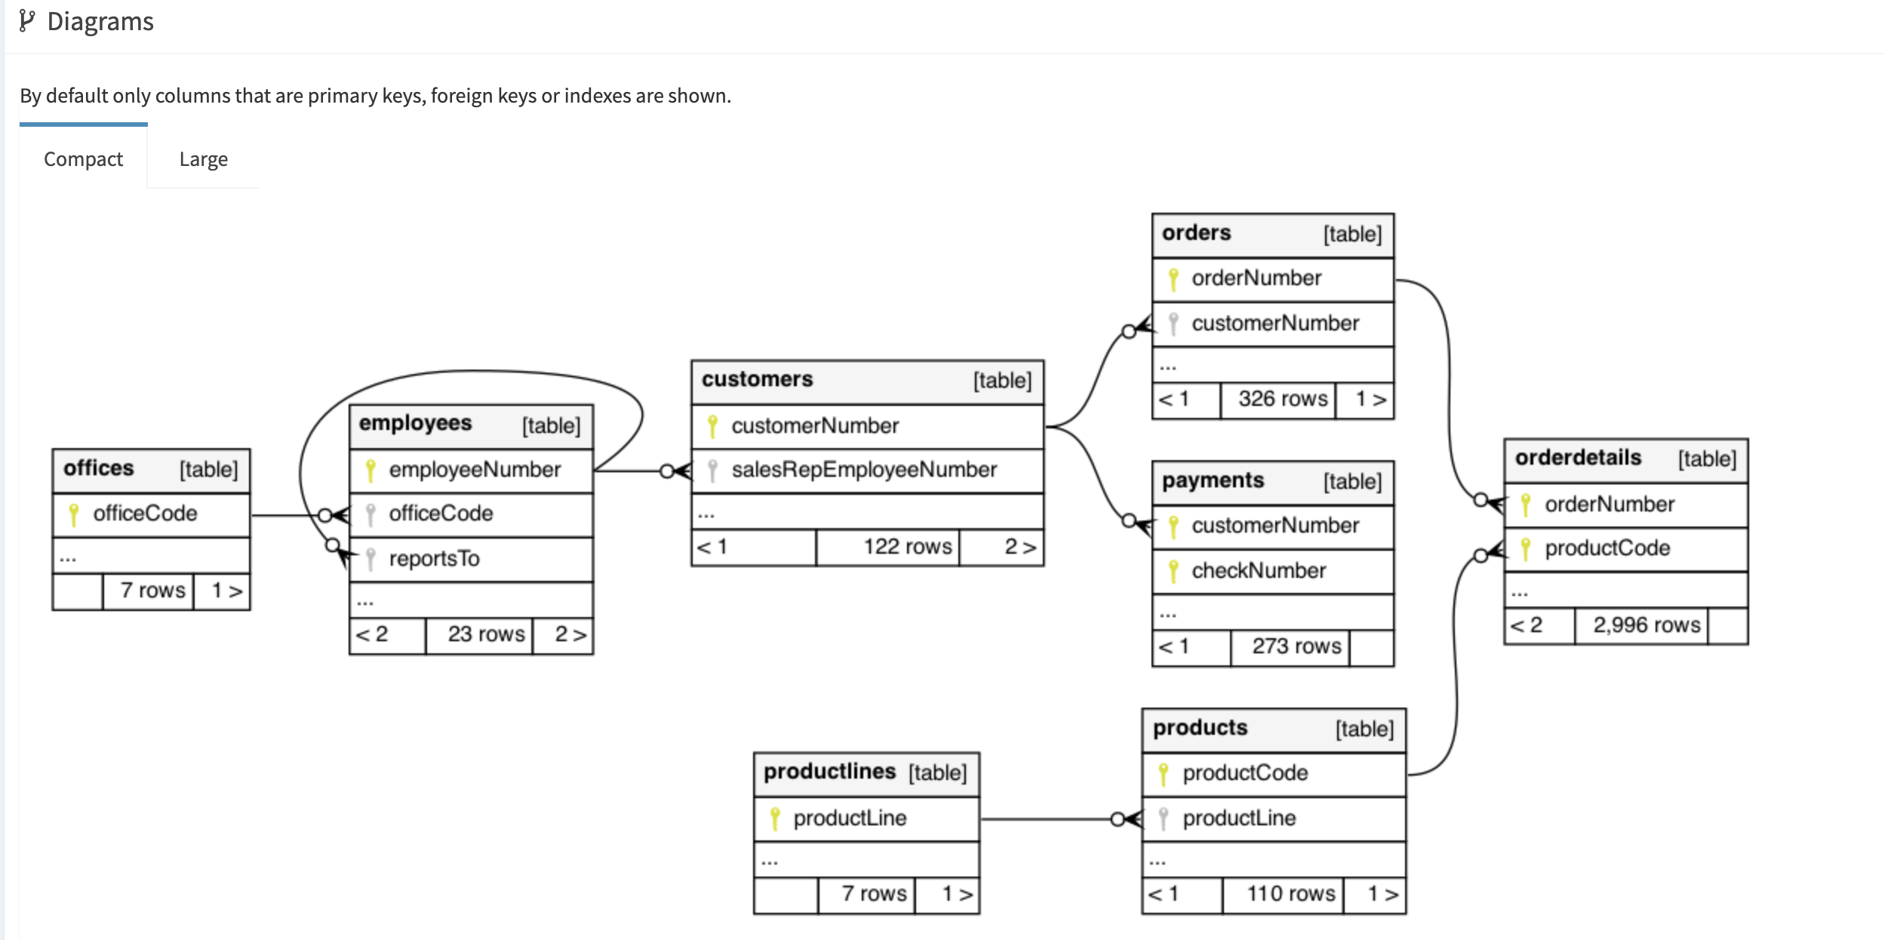
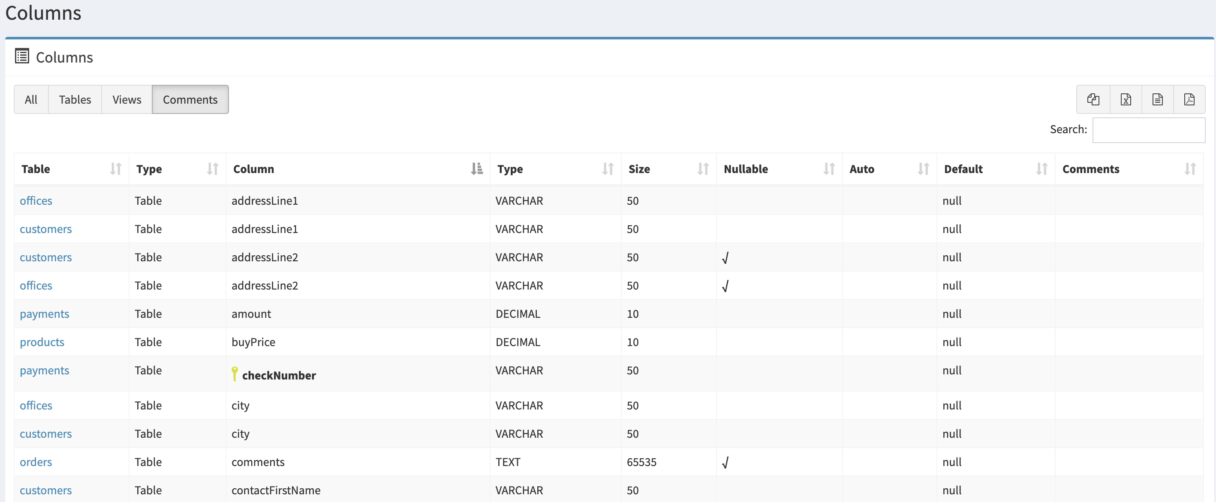
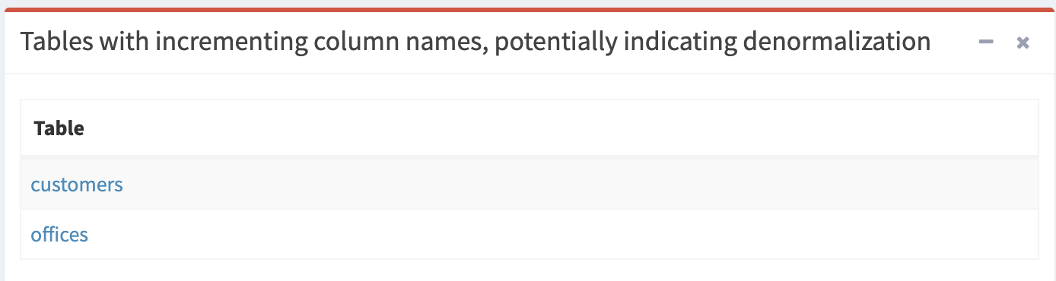
We analyze the source system schema & document mappings
Approach Slide

Slide 51
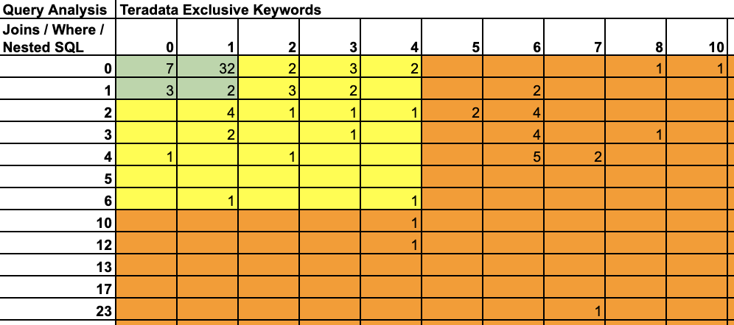
We leverage a hybrid approach to assess the process complexity
For Business Processes: We leverage workshops, surveys and process mining mechanisms to assess & understand
For Programmatic Processes: We leverage automation to assess & categorize simple, medium & complex processes
Query Complexity Matrix
# exclusive keywords
# create statements
SQLs
Automated
Query Analyzer
# joins
# where clause
# analytical functions
# windowing functions
# nested SQLs
# total lines
Check Access / Raise Access
Identified Tables required
Check Data QA in destination – To be automated
Check metadata (Index, Access, Business details)
We helped our client migrate 150+ processes by assessing 1500+ tables in less than 3 months with limited business context
Approach Slide

Slide 52
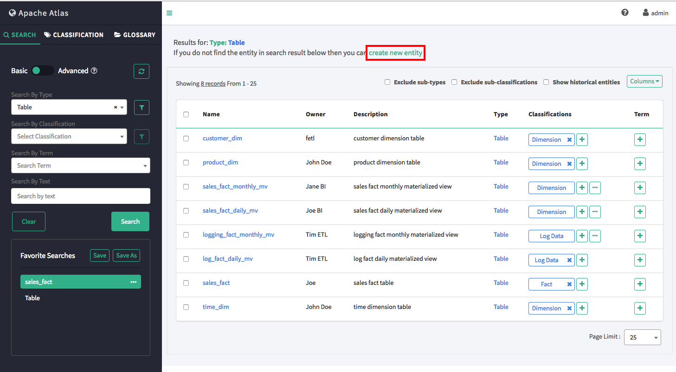
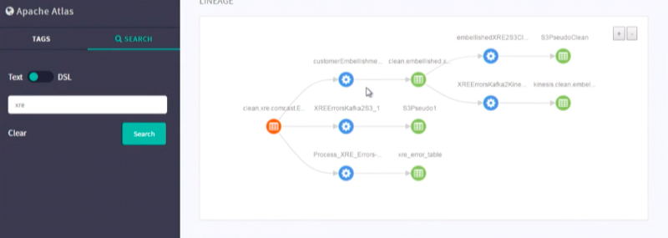
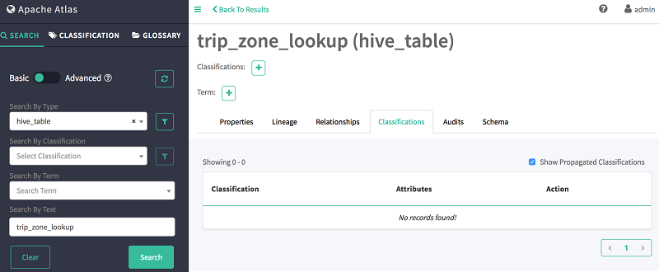
We capture all process and table metadata with lineage for collaboration
ILLUSTRATIVE
Approach Slide

Slide 53
We model the DWH by minimizing complexity & maximizing performance
CARDINALITY
COLUMN LEVEL ANALYSIS
Performance Testing
COMPRESSION
SKEW
Referential Integrity Testing
SPARSITY
DWH Data Model
TABLE LEVEL ANALYSIS
DISTRIBUTION
Data Reconciliation
SORTING
JOINS
QUERY LEVEL ANALYSIS
Model Evolution Feasibility
FILTERS
AGGREGATION
Approach Slide

Slide 54
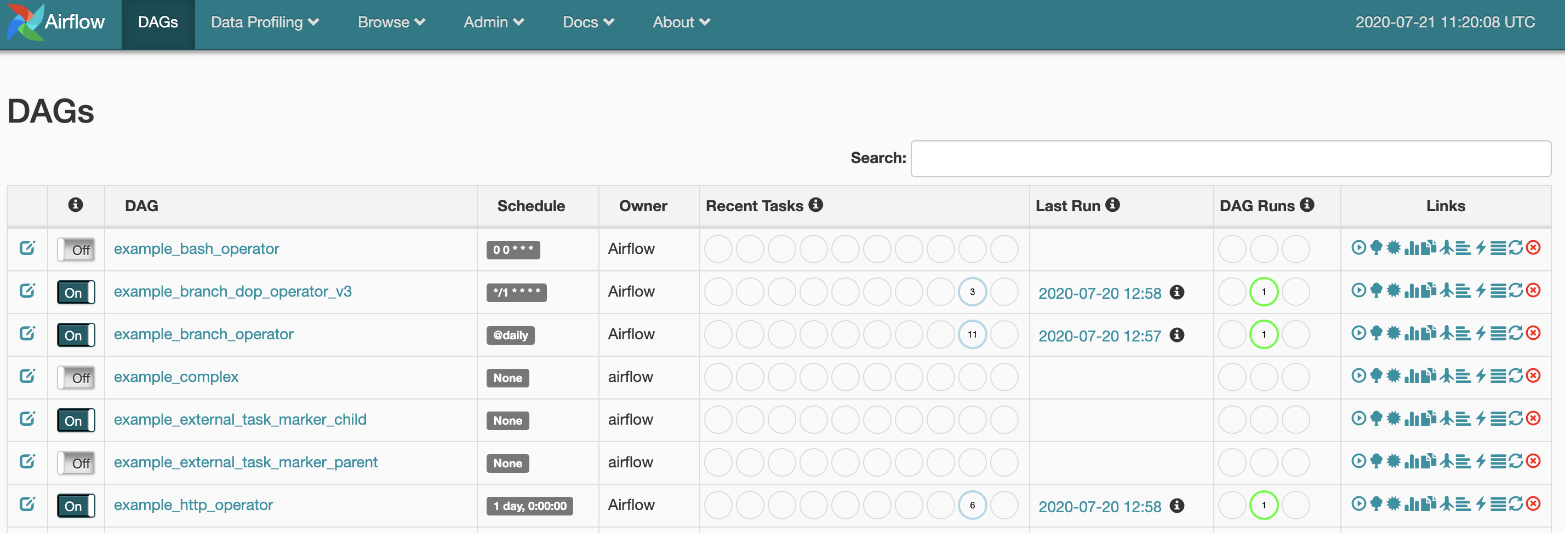
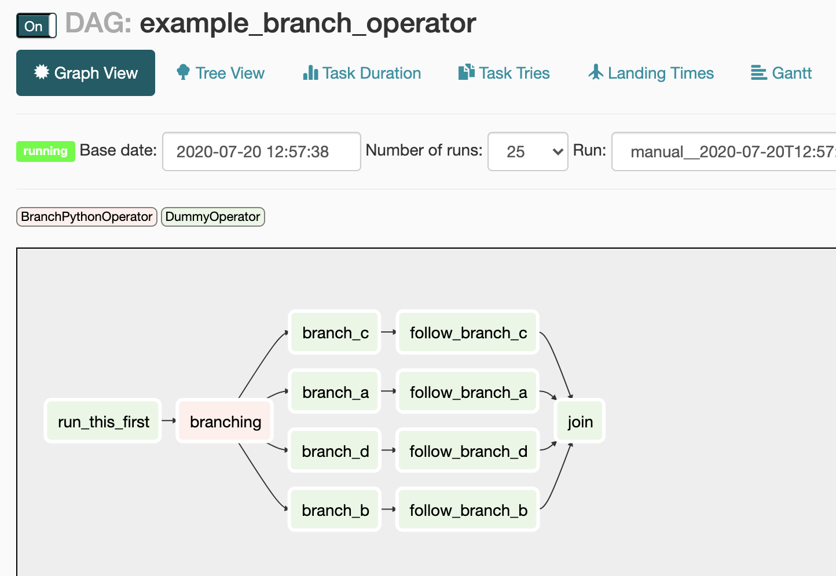
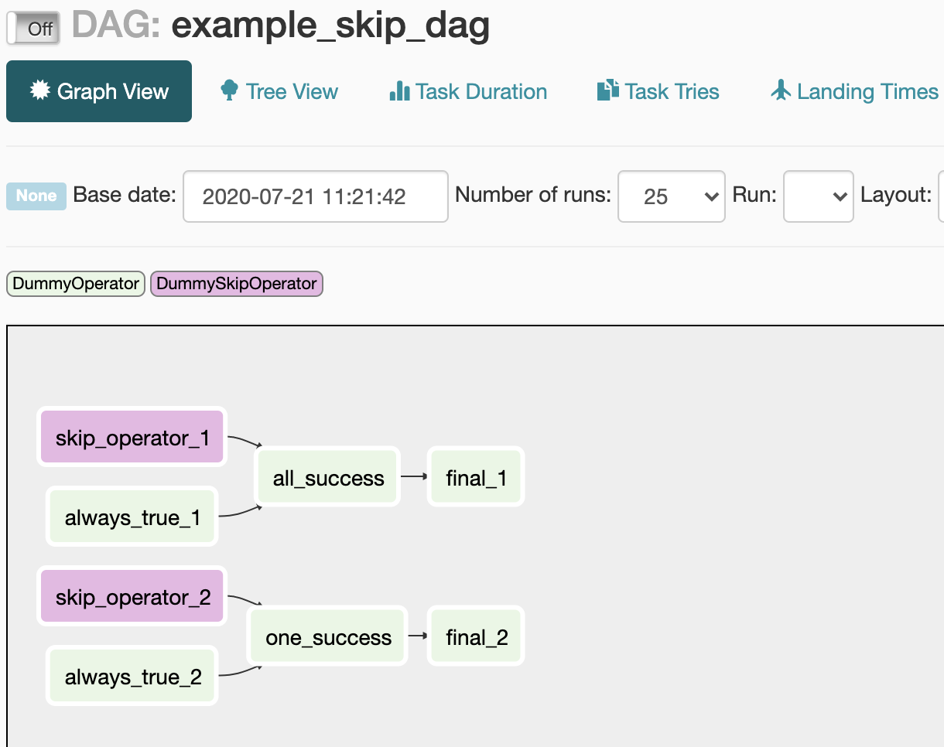
We schedule processes with all dependencies and track them to completion
ILLUSTRATIVE
Approach Slide

Slide 55
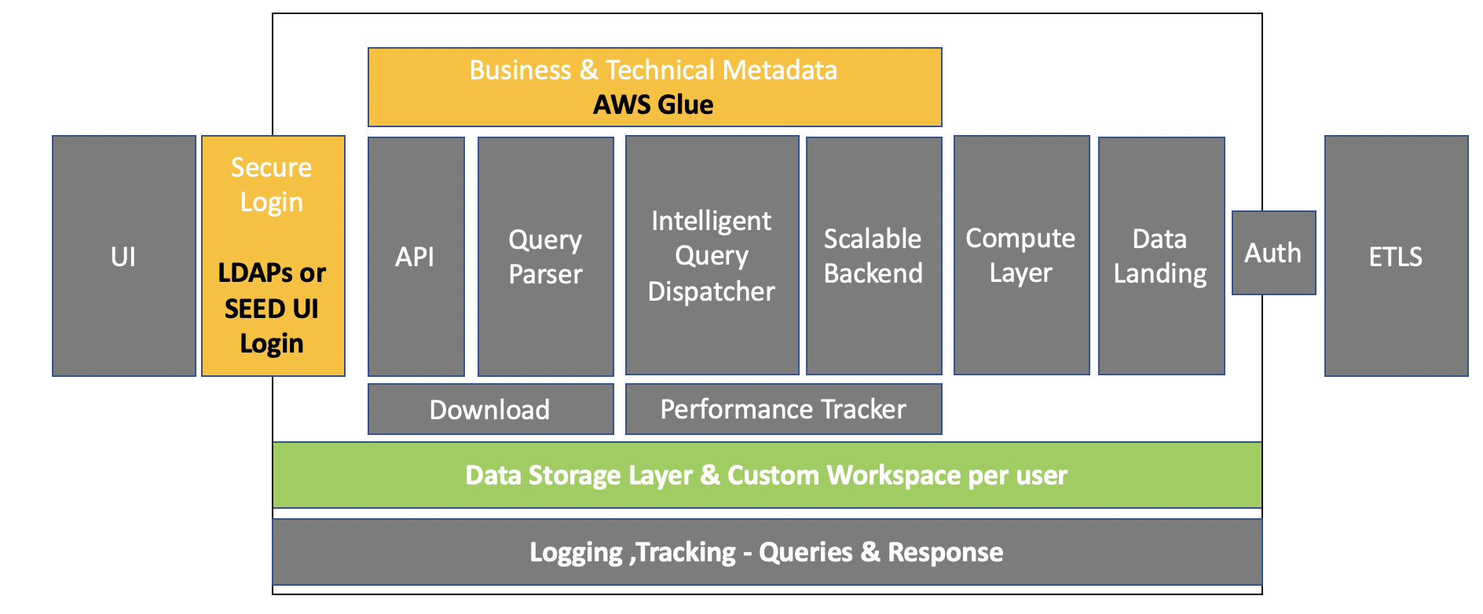
Effective Data Dissemination
Business Problem / Challenge
LatentView Solution
Business Benefit
Client ecosystem had multiple third party tools to compute KPIs
Third party solutions / software was expensive to maintain (1010 data, SAP BO)
Built a transparent and well documented KPI store using horizontally scaled up processing pipelines
ETLs run every day and all key metrics are computed as part of the process
Unified Business logic for KPIs – single source of truth
Visibility and access to KPIs for widespread use across enterprise
Approach Slide

Slide 56
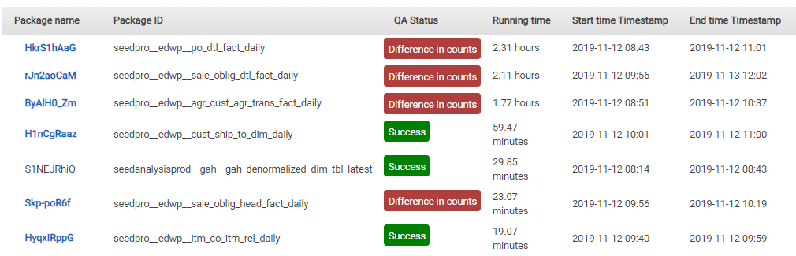
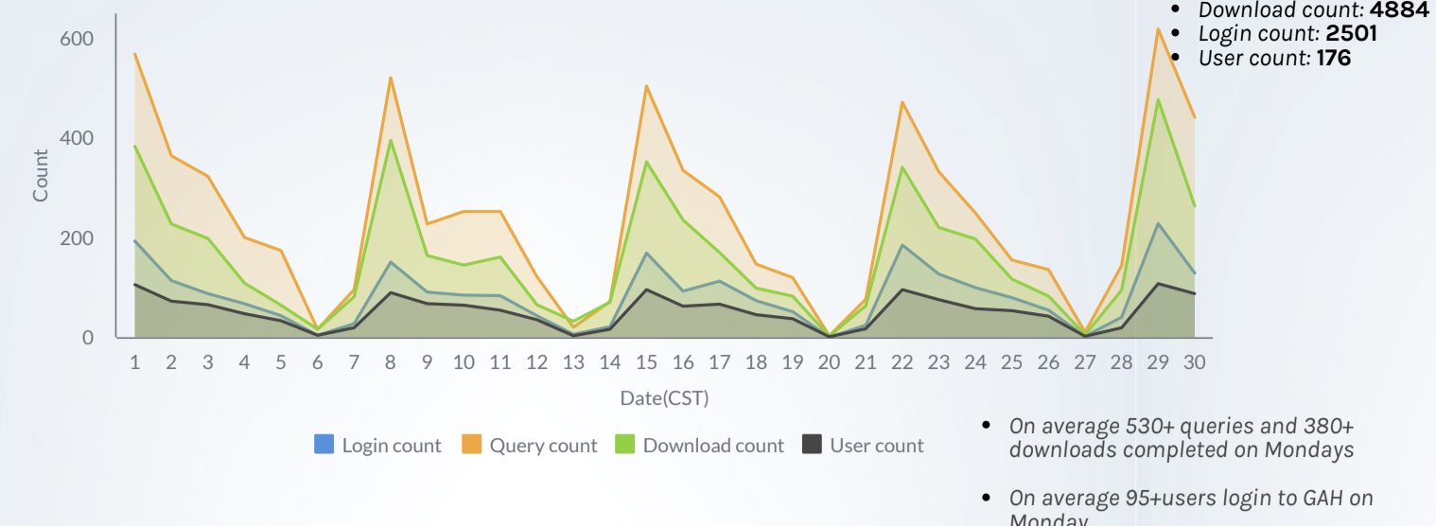
Automated Data Quality Monitoring & End to End Operational Visibility
Business Problem / Challenge
LatentView Solution
Business Benefit
Data integrity issues it undergoes transformation and blending (multiple source of records)
Gaps in data migration (master data and transactional data)
Automated data quality monitoring in a dashboard as part of every data ingest process
Configurable interface – Define own metrics and condition
Data quality was tracked both at a data size (row count) level and metric level (e.g. sales for transactional dataset)
Pro-actively fix the missing data or data corruption issues as part of the ingest
Reduce manual intervention
Published Data Quality for Trust
Tracked Utilization for Driving Adoption
Approach Slide

Slide 57
LatentView’s Case Studies in Advanced Analytics

Slide 58




LatentView’s Case Studies in Advanced Analytics
LatentView would like to highlight the following case studies
01
02
03
04
Product Recommendation
Propensity/ Lapsation Modeling
Customer Segmentation, Churn
Risk & Fraud Analytics
Built an innovative recommendation engine that combined customer segmentation, user-based collaborative filtering and market basket analysis
Developed customer lapsation / revival propensity models to win-back lapsed customers through improved targeting
Built a classification model to predict disinvestments by combining multiple data. Mitigated the churn risk by acting upon the actionable variables.
Fraud identification and detection, and multiple project engagements across Risk & Fraud Analytics

Slide 59
Why LatentView would be a good partner for Sohar Bank
Knowledgeable and Effective Delivery Team
Expert Advisors & Governance from BFSI space
Detailed Solutioning Approach with proposed timelines
Expertise in Large-Scale Data Engineering and Data Science Engagements
LatentView’s Team has designed, developed and executed multiple Datawarehousing and BI programs of this scale and are well aware of the challenges and pitfalls that will arise of such a complex program.
Expert panel from BFSI space will be brought into this engagement for better governance and working closely on the domain standpoint with in-house data services, engineering and analytics workforce
After a thorough analysis of Sohar International RFP’s requirement, LatentView’s proposed approach is slightly different from the Bank’s requested plan as per our experience dealing with other clients of similar engagement. However, the entire program will be delivered within the 28 months duration as requested.
Helped in data migration, building a large-scale data platform for various clients in multiple industries.
Cross-pollinating ideas from cloud and on-premise implementations

Slide 60
Thank You

Slide 61





Recommendation System to Increase Share of Wallet
Largest Food Distributor in US
The Problem: In an industry where customer acquisition is fairly expensive, this company’s repeat orders were at a low 4%
The “Before” State
LatentView Solution
The “After” State
Sales teams tried to sell new products to existing customers based on shallow analysis of previous transactions and ‘gut’ feel
Build an innovative recommendation engine that combined customer segmentation, user-based collaborative filtering and market basket analysis
20% increase in value of new orders from existing customers. Higher customer satisfaction due to precise recommendations
Collaborative Filtering
Market Basket Analysis
Items Purchased:
Items Purchased:
Market Basket Analysis performed for all products bought by customers in a segment. Select the product with highest likelihood to co-occur in the basket
Similar
Customer B
Milk
Eggs
Milk
Eggs
Bread
MILK | EGGS | OLIVES | BREAD
Customer A
Customer C
TRX1
Milk
Eggs
TRX2
Recommend Bread
User-User Similarity - similarity is calculated between customers within a segment based on common products in basket using Cosine Similarity
TRX3
Recommended
Bread
TRX4
Recommendation Engine
Combine the recommendations from the 2 algorithms to generate the final recommendation
For a Customer who purchases Milk & Eggs, the product with highest affinity is Bread
Notes:
Sysco – Recommendation Engine
Business Objective:
Analyze the sales transaction files to recommend new items for each individual customer to purchase. These recommended items should not have been purchased by the individual customer in the past
Identify products that frequently co-occur in a basket to strengthen the cross sell recommendations
Prioritize recommendations based on Customer Value
LatentView Solution:
The methodology can be divided into three parts
Customer Segmentation
User Based Collaborative Filtering:
Market Basket Analysis
Final Recommendations: Generate the final recommendations by combining the collaborative filtering and market basket analysis outputs
Business Benefits:
With the help of the recommendations generated, potential customers can be targeted for cross-selling
Prioritizing the customers to be targeted using the RFM scores generated for each customer

Slide 62




Collections Propensity/Lapsation Model to win-back the lapsed customers
Client is a Large Global Insurance Company
Business Objective
Build customer collections propensity models to win-back the lapsed customers which directly benefits the bottom line
LatentView Solution
Developed customer lapsation / revival propensity models to win-back lapsed customers through improved targeting
Business Benefits
Over 300% improvement in overall win back of policies (8% to 37 %)
Around 10 times improvement in win-back of policies that have lapsed for more than 1 year
Methodology
Data Collection, Cleaning & Transformation
Exploratory Analysis
Segmentation & Propensity modeling
Strategy for collection agencies
Test/Implement strategy and Refine
Notes:
MetLife – Collections / Lapsation Modelling
Objective : Build customer collections propensity models to win-back the lapsed customers which directly benefits the bottom line
Methodology :
1) Data Collection, Cleaning & Transformation :
Data collection across Policy, customer, product, channel, interaction and transaction levels
Data aggregation and cleaning at the policy level
Transform variables as required to linearize relationships
Identify key variables using exploratory analysis
2) Policy Level Propensity Model Scores
Exploratory analysis to identify key variables that impact customer lapsation
Policy-level scoring models that enable a segmentation of policies for targeted and prioritized collection efforts
Multiple models built based on the type of policies (Protection, Investment, Health, Child etc.), type of lapsation (lapsed, premium holiday), etc.
3) Rank Order & select customers at high risk
Of Lapsation
Identifying the customers on whom collections efforts will be most effective by rank ordering scores obtained from the lapsation models based on risk
Identifying the most appropriate channel of contact for various customer segments based on insights obtained through exploratory data mining
Track the performance of analytical models periodically, through feedback from the next step (skip-trace) and refine the models as required for performance
4) Strategy for Collections agencies
Define communication strategy for different customers through different channels
Provide the right contact vectors (time to contact, frequency, communication channel etc.)
Strategy for skip trace (non-contactable cases) by running campaigns for updating records
Key Findings :
ULIP policies have higher revival rate compared to Non-ULIP policies
Self-Employed customers exhibit a higher win-back propensity to compared to Professionals
Win-back of lapse policies is directly correlated to the time since lapsed

Slide 63




Our Experience working with a Leading Asset Management Firm
Leading Financial Services firm in UK operating in 50 Countries
CONTACT PROFILING / SEGMENTATION
Digital transformation & Data driven strategy for Client Services
Create better engagement with Clients (Institutional & Wholesale) to
Customer Profiling
Engagement Score
Understand Clients & engagement better
Identify Opportunities & Risks
Increase Engagement & Investments
Reduce Retention risks & Disinvestments
Solution: Consultative Recommendation & Implementation
Early Warning of Disinvestment
Recommendation for Cross Sell
Assessed Analytics/Data maturity, Technology landscape & Execution feasibility
Recommended, developed & implemented following 4 Analytics streams
RETENTION
GROWTH

Slide 64

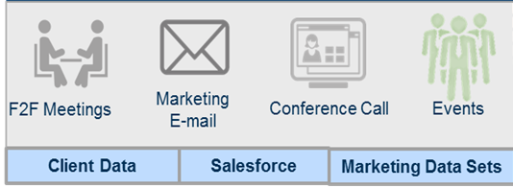

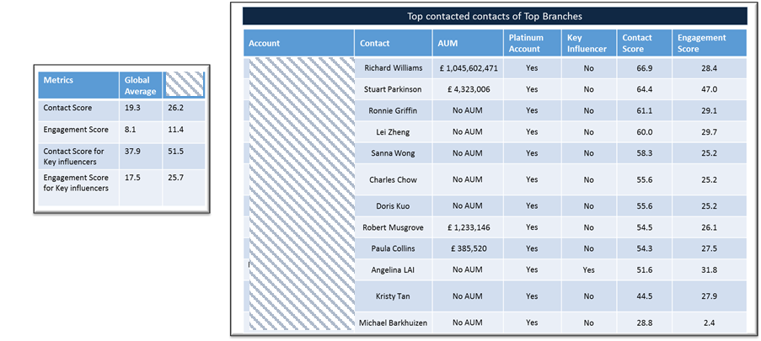
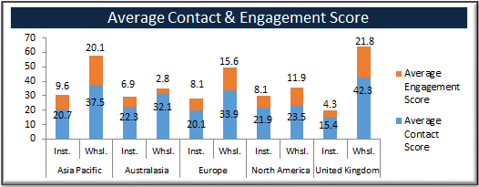
1. Global Client Coverage – Engagement Scoring & Contact Profiling
(Institutional & Wholesale)
Global Client Coverage
Business Context: High correlations between higher engagement and business flow. However, Evidence of over-communication - 2.9k contacts were sent more than 30 emails (<10% Open Rates) and case of under communication for smaller clients.
Client Interactions
Solution: Contact profiling derived from using various sources of customer, interactions & engagement data enabled quantifying level of engagement / interactions (Engagement Scoring) across all clients and prospects (Institutional & Wholesale) base.
64
F2F Meetings
Marketing
Email
Servicing Interactions
Event Invites
Output: An aggregated and historical view of client contact across all channels and markets
Visibility of contact frequency by client type, size, value
Assessment of contact responsiveness within a firm
Clarity of client engagement with previous communications
Contact Profiling Scores
Priority of Interaction
Quality of Interaction
Contact Score
Engagement Score

Slide 65






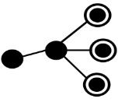
2. Institutional Client Retention using Machine Learning
Analysis Period
Challenge: Accuracy of the current risk rating system to predict disinvestments in institutional clients was only 20% accurate.
Observation Period
Disinvestment Period
12 Months
12 Months
Solution: Built a classification model to predict disinvestments by combining data related to Investor’s interactions, Transactions, Consultant ratings and Product performance. Mitigate the churn risk by acting upon the actionable variables.
Statistical Model Building Process
Total
Mandates
X
Y Mandates
disinvested >50%
Z mandates -‘High’ risk by current system
Analyse the possible triggers for disinvestment
Interaction metrics - Campaign, Meetings and Cases Transaction metrics - Gross sales and redemptions Fund Performance and Consultant ratings
Impact: Institutional Clients - Accurate predictions of disinvestments in 65% of the cases leading to retention of mandates worth 444 Million Pounds. Early risk prediction provided enough time for risk mitigation.
Predict the probability of disinvestment
Disinvestment (Yes/No)
Logistic Regression / Random Forest / GBM
Validate with current risk ratings
Increase ability to predict redemptions by establishing a consistent global measurement standard
30% of 2351 mandates - used to test the model
Model identified £444 Mn out of £684 Mn
redemptions i.e. 40% more than current process.
Data Sources
Meetings
Meetings Content
Engagement Score
Consultant Ratings
Fund Performance
Triggers for Disinvestment
Analytic Process
Impact
High Impact | Medium Impact | Low Impact
Meetings Characteristics Transaction Behaviour | Mandate Performance Characteristics Consultant Rating Characteristics | Servicing Requests Marketing Campaigns
Retention Model
Logistic Regression
Retention Model captures 40% more disinvestments than the current risk evaluation

Slide 66






3. Campaign Targeting to Increase investments (Top Up & Cross Sell)
The Customer services team targeted Institutional customers based on pre-set rules not considering past behavior and targeted all customers using a single strategy thus having less effectiveness
Recommendation engine using RFM & Similarity index to identify best set of prospects for the fund, segmented customers based on their behavior/characteristics & propensity to invest
Average Campaign engagement rate increased from
12% to 18%
Target Identification Process
Customer segmentation and Message coherence
Identified Targets
Prospects invested in this sector through other players
Prospects Investing in this Sector for the first time
Clients Investing in this Sector for the first time
Clients investing in this fund for first time but invested in the sector before
Clients invested in this sector through other players
Identify High potential prospects for this fund
Wallet Size >£100k per month, plus
A strong allocation into relevant Sector
Final
List of
target
accounts
for
Campaign
Segment the identified prospects based on characteristics and behaviour
Send Personalised marketing content for each segment to engage customers more effectively
Pearson Similarity Index Model based on
Allocation behaviour across sectors
Investments in client's company & market share
Look-Alike Model between
Client and Prospects
Markey Share
Client’s Financials
RFM – Recency, Frequency, Monetary model – identify high wallet frequent investors
Customer Segmentation technique based on Frequent, recent and high investors
Recency
Frequency
Monetary

Slide 67








4. Alternative Data Sources to Improve Investment Analysis
This analysis consisted of 54 stocks split between two funds as prescribed by the client
Base
Measure
Stock Performance
Data Scraping
Entity Extraction
Standardization
Normalization
Base Measure
Stock
Performance
Scoring
Algorithm
ΣBase Measure
+
ΣAlternate Measure
Internal & External Perception
Alternate Data
Quality Score
Performance Score
Event Score
Alternate Measure
Company events
Data Extraction & Integration
Fund Scoring
Evaluation & Inference
Relevant information from shortlisted data sources is extracted using custom web scrapers and advanced pattern matching algorithms.
For a given company each variable is given a score between 0-1 in relative to the other companies in the fund. This score is assigned basis the percentile range of its z score
All the variables are fed in to get metric level score.
Each metric is assigned a weight & then summed up to get a company level alternate score
Z score normalization to preserve the range (max & min) & introduce the dispersion of the series (standard deviation / variance)
For e.g. z score value > 90th percentile is assigned a score of 0.9 & z score value > 80th but <90th percentile is 0.8 and so on.
This score is then supplemented with existing base measure to get overall stock score

Slide 68
4. Alternative Data Sources to Improve Investment Analysis
Stock Score= Σ Base Measure +Σ Alternate Measure
Base Measure: Mean value of key stock performance indicators | Alternate measure: Mean of weighted alternate performance indicators
Fund F1
Fund F2
. . . .
Fund Fn
Funds and Stocks of selected asset management companies
Stock S1
Stock S2
Stock S61
Stock S62
Stock Sn1
Stock Sn2
To each stock , the “Base Measure” is coupled with its “Alternate performance measure“ and given a score between 0 & 100.
This score is relative measure i.e. score can be used as measure to compare between different stocks at either overall or metric level.
The weight assigned to each factor of alternative data is customizable and helps in benchmarking companies .
Stock S3
Stock S60
Stock S63
Stock S120
Stock Sn3
Stock Snn
Alternate Data Ingestion
For each stock the metrics derived from alternate data is attached to its existing base measure
Base Measure
Company Fitment
Revised Stock Performance
Fund F1
Fund F2
. . . .
Fund Fn
Identify stocks with low score and recommend stocks with high score as replacements
Stock S1
Stock S2
Stock S61
Stock S62
Stock Sn1
Stock Sn2
Stock S3
Stock S60
Stock S63
Stock S120
Stock Sn3
Stock Snn
Positive Trend
Neutral Trend
Negative Trend

Slide 69
Risk & Fraud Analytics for a Leading eCommerce Marketplace
New Fraud Identification and Tagging
Mass Registrations - BOTk Monitoring
Identifying new fraud tags by creating a rule-based approach by analyzing historical transactions
Monitor account info change metrics to identify BOT attacks and prevent successful transactions from mass registrations
Unauthorized Chargeback
Deep-dive analysis to identify reasons for chargebacks. Detect anomalies across buyer information, seller information, billing data, delivery data
Stolen Financial Detection and Analysis
Prevent Stolen Financial fraud by analyzing historical card usage and product purchase data
Account Take Over (ATO)
Identify False Positive Rates of Existing Fraud Rule Engines
Detect ATO fraud by developing rules thorough monitoring account changes, address verification, buyer transaction information
Improve customer experience by detecting and reducing false transaction declines by fraud engines

Slide 70
New Fraud Identification & Tagging
The “Before” State
LatentView’s Solution
The “After” State
Client’s current fraud model in place was obsolete and was unable to differentiate between fraud types causing leakages
This let to sellers being actioned later than supposed to and leading to buyers filing chargebacks, losses and payouts
Developed a rule based approach to detect new fraud tags by analyzing the customer footprints and historical information
Identified KPIs and derived definitions from existing features to identify Buyer/Sellers MO’s.
Created a large base dataset for prediction algorithms to be trained on
Increased detection rate by almost 40%, while fraud transaction detection time reduced to within 5 days compared to earlier 3 month window
Early detection lead to faster restriction of fraud accounts saving $s and improved customer experience
Identified 12 new types of fraud tags and developed rules to detect them enabling significant $ savings
New Fraud Identification Process
Business Impact
Data Understanding
Surface level investigation on historic data to understand fraudulent transactions patterns
100 days
Detection rate
~5 days
Exploratory Data Analysis
Analyzed existing KPIs, chargeback process and created new KPI’s over existing ones to better identify fraud tag
Manual Deep Dives
Performed Deep Dive analysis on the sample transactions to identify buyer/seller fraud MO’s
Validation of MO’s
Validated the rules created for identifying fraudulent MO’s on the entire chargeback population
Automated process
Automated the process by coding identified rules necessary for tagging a future transactions
12 new fraud tags | 26,000 cases detected | Approx. $ savings = $3.9 million

Slide 71






Unauthorized Chargeback Tracking & Analysis
The “Before” State
LatentView’s Solution
The “After” State
Monitoring of chargeback rates using dashboards
Rules/Model to classify Unauthorized Chargebacks into Stolen Financial, Account Take Overs, Buyer Related
Rules based on velocity parameters to block similar MO from happening again
Evaluate the performance of machine learning models which detect fraudulent transactions
Identified high-value chargebacks immediately and intercepted further delivery of product by identifying fraud details
Identified list of addresses from where high velocity of chargebacks were anticipated
Classified addresses into types to detect possibility of fraud in future – created flags to detect the same
Blacklisting - Reported lists of buyers, addresses to be blocked that were otherwise conduction fraudulent transacting
When unauthorized chargebacks are filed, the client pays out the buyer first, and then attempts to recoup the amount from the seller
In many cases, loss is borne by the client leading to increased net loss
Understanding the root cause of the chargeback was a tedious time consuming process with multiple touch-points and iterations
No actionable insights were available in a consolidated space
1
2
Unauthorized Chargebacks
Approx. $ Savings: $200K/month
Approx. $ Savings: $350K/month
Monitoring Chargeback loss rates, arrival rates using Dashboard
Deep Dive on buyer information, seller information, billing data, delivery data
5
Payment Provider
Managed Payments
3
4
Create a blacklist to block known fraudsters based on address, IP, card information, machine ID
Provider’s Guest
Provider’s Member
Guest
Member
Use Card Holder info to identify MOs of chargeback transactions
Performance evaluation of rules/models to balance security with customer experience
Reduced loss rate
from 5% to 1%
Intercepted High Value Chargebacks: $50K/month
Restricted fraud account purchases for a top seller: 300 accounts/month
Remedy Actions on member accounts that were under ATO attack: Reduced loss rate from 50% to 10%

Slide 72
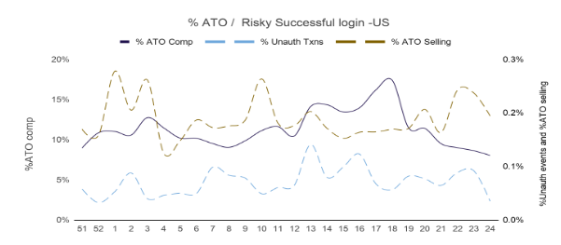
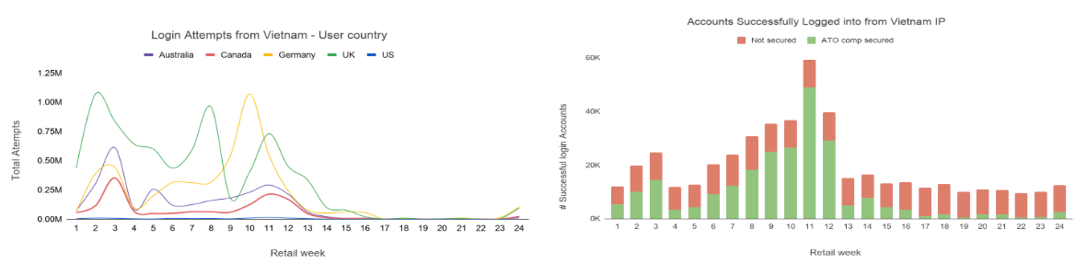
Account Take Over (ATO)
The “Before” State
LatentView’s Solution
The “After” State
Fraudsters take over customer accounts by stealing their personal information and transact either through credit cards stored in the account or a stolen card
This leads to increase chargebacks as well as drop in customer experience and satisfaction
The client did not have a holistic view of detecting, tracking and mitigating ATO cases in one place
Create a rule based logic to flag Account TakeOver fraud cases, identify areas of data leakage, and develop rules/policies in place to check fraudsters from accessing accounts
Monitor ‘account info change’ and login information to detect anomalies that indicate ATO.
Develop dashboards for week on week tracking and deep dive into each case to detect leakage
Improved user experience by correctly identifying ATO ‘Compromise package’ drop and reducing false positives rates
Detected dormant accounts and proactively push for password changes to prevent ATO
Reduced loss by detecting possible ATO cases through dashboards
Track Chargebacks
Analyze Consumer Data
Detect leakage and develop rules
Monitor new cases
Review policies and recommend updates
How many compromise packages were dropped after fraudulent attempt?
Which accounts witness failure to successful login attempt?
What are the trends of account information change?
Insights
Which IP address/Sub-net/region are most ATO cases coming from?
What are the trends of attempts, failure, and successful login?
Can login failure trends predict Account Take Over?

Slide 73
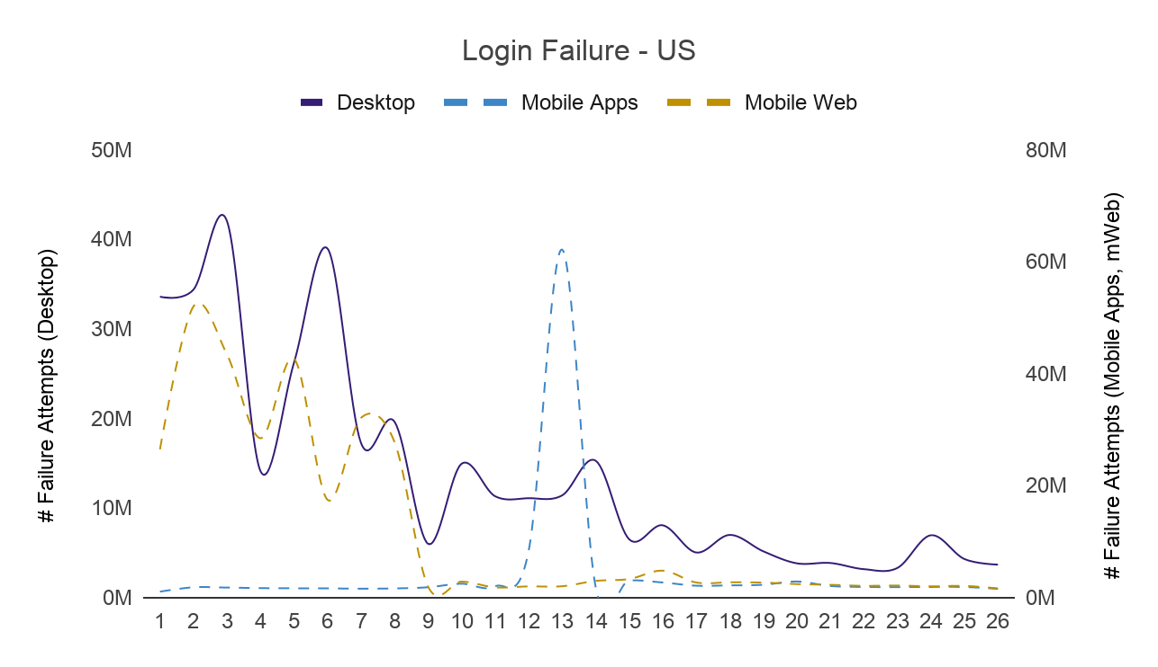
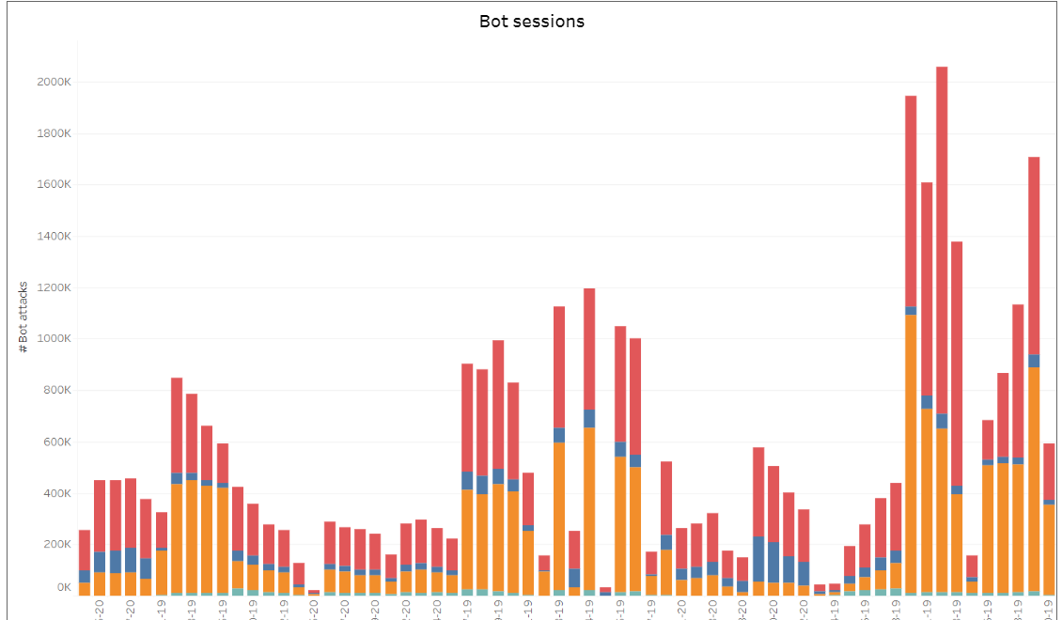
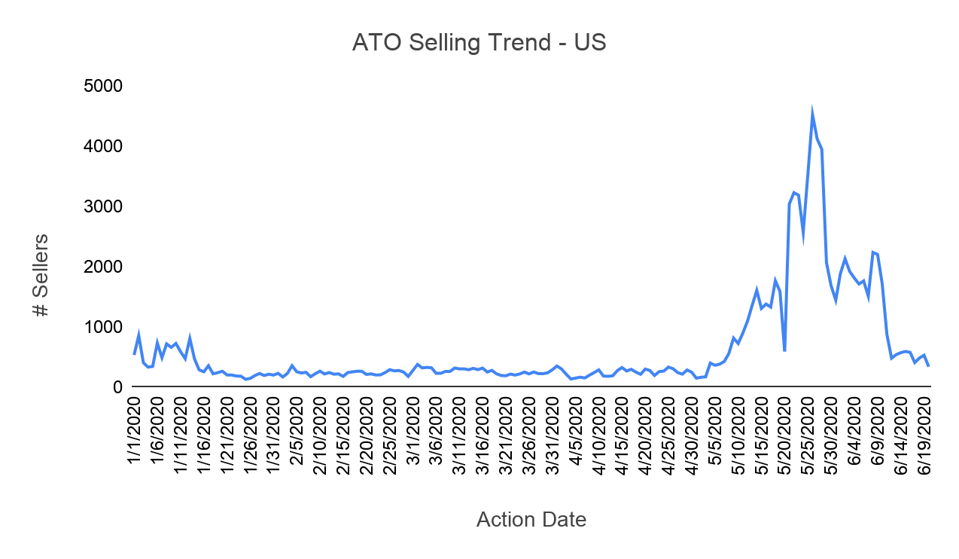
Mass Registrations - BOT Attack Monitoring
The “Before” State
LatentView’s Solution
The “After” State
Developed dashboard that tracks mass registration metrics to detect BOT attacks early
Monitor metrics such as Account Info Change (phone number, email, password, address changes), session velocity, and CAPTCHA to develop a rule based algorithm to detect attacks
Pin pointed countries from where large surges of BOT attacks/brute force login attacks are from
Identified fraudulent email address and IP subnets that were blacklisted from where mass registrations occurred
Prevented leakages in existing BOT attack fraud rules by detecting accounts that pass through despite being flagged
Reduced time to action for BOT attack cases through detailed deep dive dashboards and velocity rules
To track and identify BOT attacks for an ecommerce client
BOT attacks usually lead to mass registration, affecting user traffic, compromising user accounts and mass chargebacks in the future
Bot Detection
Rules and Captcha to reduce bad bot traffic to solve problems such as Sign-in brute force, mass registration attacks, spike at guest registrations.
Improved user experience
Tracking page level data on registration page to find barrier on user experience during creation of account by preventing bot traffic.
Login failure tracking
Regular monitoring of total login attempts. Deep dive analysis when there is increase in login failures across countries
Account Monitoring
Monitoring registrations, logins of customers, account takeovers, bad buying activity, suspensions and identify leakage from them
Login Failure Trends
BOT Session Tracking
Account Take Over Trends – US (Sellers)

Slide 74
Stolen Financial Detection and Analysis
Business Objective
LatentView’s Solution
The “After” State
Many of the ecommerce marketplace transactions are performed using Stolen Financials
These transactions eventually convert to loss as the card holder files for chargeback
Detection of these transactions is tough as the fraudster creates a legitimate account and fraud is not identifies until the chargeback is filed
Analyzed historical Stolen Financial (SF) data to identify indicators of fraudulent activity
Developed set of rules to detect future SF cases
Deep dive into specific cases to identify varieties of SF cases
Identified specific types of SF cases helping the client improve their fraud models to detect new tags faster
Developed a framework that identified SF fraud based on historical failed transaction and product purchase pattern to detect reuse of Stolen cards quicker than earlier
Stolen Financials – Guest Account
Stolen Financials
Stolen Financials – Multiple Card Attempts
Stolen Financials – Foreign Account
Stolen Financials – One Transaction
Stolen Financials – Account Take Over
Metric | Rules
Email Velocity | Restricting guest accounts based on historical email velocity
Machine ID | Restricting guest accounts with more than 5 declined attempts with same machine ID in past 1h
Cookie ID | Restricting accounts with more than 500 attempts with same machine ID
Cards/Coupons | Restricting accounts that have bad history based on Cards or Coupons used

Slide 75
Identify False Positive Rates of Existing Fraud Rule Engines
The “Before” State
LatentView’s Solution
The “After” State
To identify the fraudulent users, along with the regular rule based approach, Fraud Rule Engines are placed as a secondary check
However, the rule-engines are prone to action users who are legitimate
These often end as bad user experience
Identified scenarios where leakages from Fraud Rule Engines occurred
Curated list of metrics to monitor the effectiveness of the existing rule engine
Actioned only those users who are fraudulent and thereby improved the false positive rate
70% reduction in mistagging legitimate users
Ideal scenario: Users should be actioned after Claim (fraudulent transactions)
Actual scenario: Users getting actioned after claim is less than 10%
53% of the users were wrongly actioned even before they perform a fraudulent transaction
Only 38% ended up being fraudulent
 | # Seller | % GMV | Claim Rate | SF Loss Rate
No Claim | 53% | 7.3% | 0.0% | 0.0
All Claims ->SMIR | 3% | 1.3% | 5.3% | 0.0
SF Rate >= 50% | 23% | 0.8% | 39.1% | 847.5
Claim Rate >= 5% | 15% | 13.0% | 14.0% | 124.2
Rest | 6% | 77.5% | 3.1% | 3.6
WHY DOES THIS HAPPEN?

Slide 76
Credit Risk for a large Digital Payments Provider
LatentView worked with a large digital payments provider to manage the credit risk across its large portfolio of digital customers. Credit risk is most simply defined as the potential that a bank borrower or counterparty will fail to meet its obligations in accordance with agreed terms. The goal of credit risk management is to maximise the risk-adjusted rate of return by maintaining credit risk exposure within acceptable parameters.
Effective management of credit risk is a critical component of a comprehensive approach to risk management and essential to the long-term success of any organisation.
Stages of Credit Risk Management
Automated Underwriting Policy
Dynamic offer sizes and Dynamic Pricing
Monitor Performance
Next Gen Underwriting Model
Assessing the Risk appetite of the portfolio
Setting up an automated underwriting policy to approve the right customers
Custom Tailored credit limits
Risk Adjusted Margin based Pricing
Useful tool for loss mitigation
Analyse and report the repayment pattern of customers
Useful tool for Collections and Risk assessment
Implement the learnings to build a better and faster underwriting policy
Drive towards Maximum credit limits, have competitive pricing and keep losses to a minimal

Slide 77


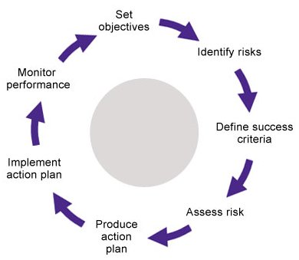
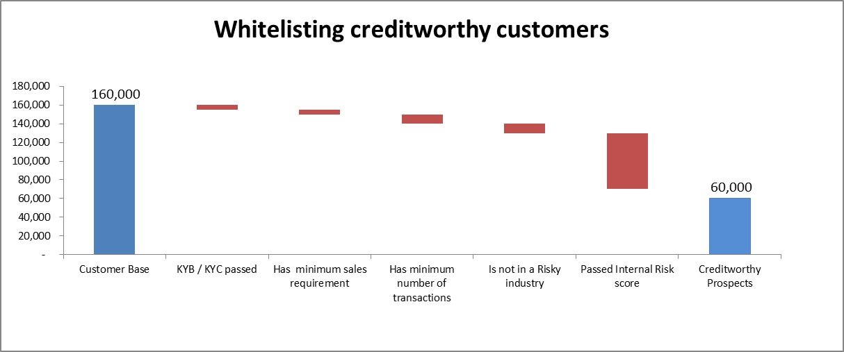
1. Automated Underwriting Policy
Business Context
LatentView Solution
Business Benefits
To develop an automated risk underwriting policy to identify creditworthy prospects from an existing pool of customers – extracting data from multiple sources of databases
Credit analysis calculates the creditworthiness of an individual or a business
Build an internal Risk score for all customers based on the variables available in database
LatentView will be able to draw the fine line between a very stringent credit policy which does not give space for whitelisting more customers vs whitelisting un-creditworthy prospects resulting in higher losses
Built by a group of analysts

Slide 78
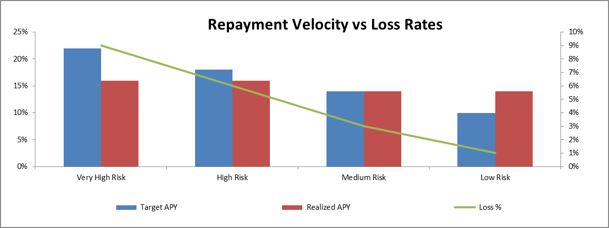
2. Dynamic Offer sizes and Pricing
Business Context
LatentView Solution
Business Benefits
The credit limit and the target APY ( price point ) may vary from customer to customer / segment to segment
How do we fix credit limits and price points for an approved customer?
Segment the approved customers based on multiple variables available and find correlation between the offer size and price with RAM and losses
Duration of exposure - a critical component of pricing engine
Minimize Rejecter rate, offer better customer experience with competitive pricing and offers, mitigate losses and exposure duration
Revenue Neutral changes made to pricing and credit offer engine
High
Very High Risk
High Risk
Price
Credit Limit
Losses
Price
Credit Limit
Repayment Velocity
Slow
Repayment Velocity
Fast
Losses
Price
Credit Limit
Price
Credit Limit
Medium Risk
Low Risk
Low

Slide 79
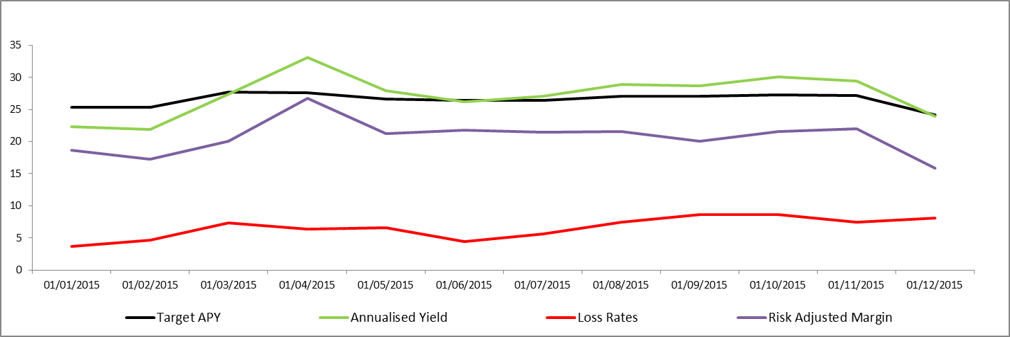
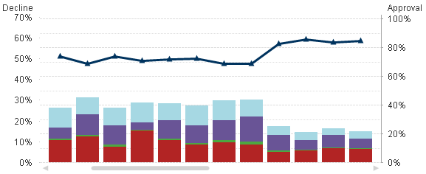
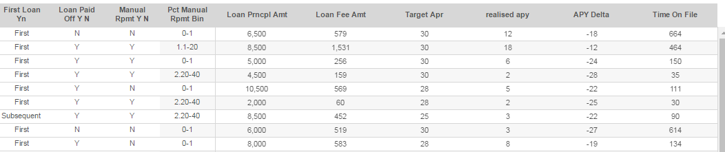
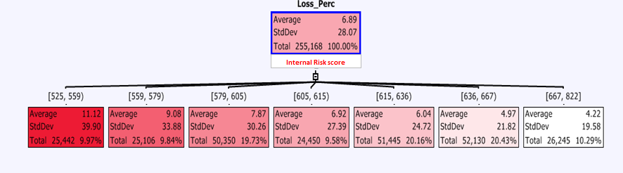
3. Monitoring Performance
PORTFOLIO PERFORMANCE
Decline Rates split by Month and Reason
Monitor Delinquencies / Automated Collections Process :
Monitor health of the portfolio through various dashboards built to identify specific problems
Build a solid collections process through automated calculations of expectations and actuals
Monitor Performance of Internal Risk Score :
Incorporate the learnings from the existing Underwriting model to build the Next Gen model – which would give us stronger results

Slide 80

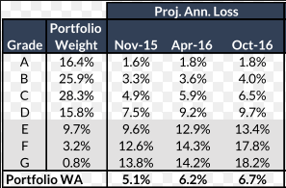
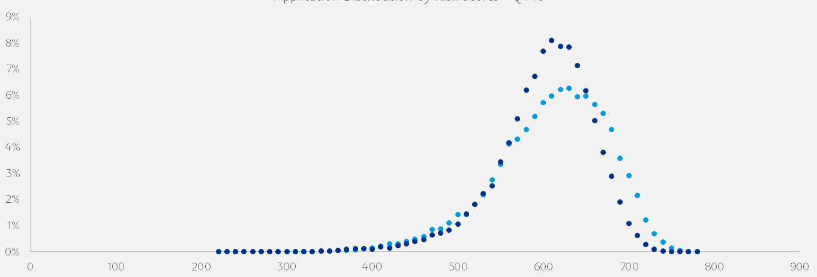
4. Next Gen Underwriting
Incorporate learnings from
Historic Loss & Charge off data
Delinquency distribution
Risk-adjusted rate of returns
To build the Next Gen Underwriting model which would
enhance customer relationship
optimize credit limits
ensure competitive pricing
minimize losses
Revision of Internal Risk score:
Various modelling techniques were employed and Ensemble modelling was found to yield the best results in identifying creditworthy prospects among the customer base
Pricing and Line Assignment Revision:
Iterative projections of Loss Rates & RAM for different pricing and line assignments are simulated to optimize the pricing and line assignment grid

Slide 81
Appendix

Slide 82
1) Co-Discover the problem along with stakeholders
Understand the current ecosystem through 1:1 interviews, remove workshops, surveys, shadowing current processes
Pre-Discovery Exercise
Context
Stakeholder
Data & Tools
Pre-read about the industry, regulations and competition
Understand about BI tools currently used
High level understanding of the data schema and databases in use
Understand the business context in detail
Key stakeholders and their roles
Current purpose served by the BI tools for each role
Day-to-day activities demanded by their respective roles
Reports and data used – importance, frequency, level of granularity
KPIs of importance and relevance to each
Challenges/frustrations with current state of data, tools, process
High level understanding of the data used across different reports
Understand the data lake, pipeline and processes
Outcomes of Discovery Stage
Discover the stated and unstated needs of different stakeholders
Identify and propose set of changes to enable BI transformation to address needs of stakeholders

Slide 83
2) Assess the feasibility of transforming to the new state
Assess the gaps in data availability, tools capability & adoption practices
Technical Assessment
Risk Assessment
Change Management Practices
Assess the capability of different tools
Benchmark performance with industry standards
Scalability, reliability and sustainability factors of the solution
Report rationalization
Risk associated with transformation to new BI tool:
Loss of data
Disruption to current scheme of work
Time taken to get results
Security & compliance
Constraints
Adoption Challenges
Assessing feasibility in transition from ‘Awareness to Acceptance to Advocacy’*
Trainings
Workshops
Frequent and open communications
Outcome of Assessment Stage
Risk assessment report – potential risks associated with transformation
BI practices maturity assessment report
*Managing Transitions, William Bridges and Heart of Change, John Kotter

Slide 84
3) Prioritize solutions that enable transition to new state
Defining a prioritization framework using ERRC grid* and laying out an implementation plan
ILLUSTRATIVE
Eliminate
Raise
Redundant Reports - Priority 1
Legacy Tools - Priority 1
Shadow IT - Priority 3
Documentation – Priority 1
Access to reports – Priority 2
Training Programs – Priority 2
Reduce
Create & Automate
Excel reports – Priority 1
KPI Rationalization – Priority 2
Latency – Priority 3
Role based access – Priority 2
Mobile Interface Support – Priority 2
Query-able interface – Priority 3
Outcome of Prioritization Stage
Roadmap to address the gaps and implement the changes identified
*Eliminate-Reduce-Raise-Create (ERRC) Grid by W. Chan Kim and Renée Mauborgne
Notes:
Shadow IT is a term that refers to Information Technology (IT) applications and infrastructure that are managed and utilized without the knowledge of the enterprise's IT department.

Slide 85

Proposed Team Structure
Sohar
International
LatentView Analytics
EXECUTIVE MANAGEMENT
CHIEF CLIENT OFFICER
BUSINESS HEAD
Steering Committee
PROGRAM SPONSOR
CLIENT PARTNER
BFSI, PRACTICE HEAD
Onsite
(Oman)
Account Mgmt
PROGRAM MANAGER
ENGAGEMENT MANAGER
PROGRAM MANAGER
PM BANK IT/OPS
PM TECHNOLOGY
PM BANK SME
BANKING SME
PLATFORM ARCHITECT
BANKING SME
DATA ARCHITECT
BI/ REPORTING ARCHITECT
LEAD DATA SCIENTIST
TEST/CI-CD ARCHITECT
Delivery Management
Legend
DBA, Modelers, Data Engineers, ETL Developers
BI/ Report Developers, Automation Engineers
Business Analysts & Data Scientists
DQ Engineers, Business Analysts, Testers
Sohar International EXECS
LATENTVIEW ONSITE
LATENTVIEW OFFSHORE

Slide 86
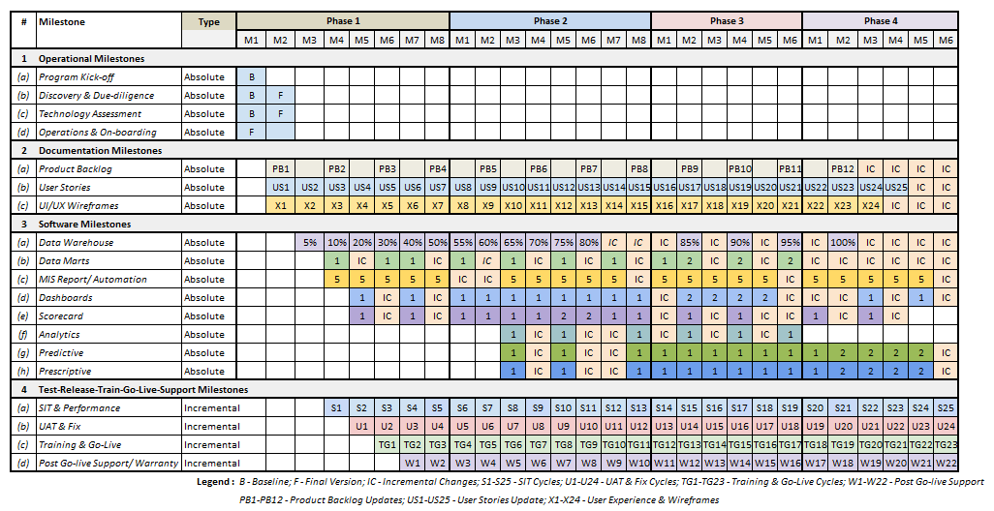
Milestone View

Slide 87
Our Data Engineering Capabilities
Applications
Data Strategy
Data Lakes
Data Warehouse
Visualization
Decision management systems
IoT Applications
Data Monetization Roadmap
Cloud Strategy & Architecture
Architecture Evolution
Data Integration / Consolidation / Harmonization Framework
Optimizing BI Investments
Data Engineering
Capabilities
Technology
Engineering
Hadoop: Hive, HBase, MapReduce, PiG, HDFS, Phoenix
Spark – Scala, Python, Spark SQL
Flume, Kafka, NiFi, Sqoop
Spark Streaming, Storm
AWS, Azure, GCP, Kylo, Qubole, Databricks
Structure Data Flows
Ingest streaming & batch data
Data storage and data model
Batch and Real time processing
Real-time, Graph, Search & Iterative workloads
Orchestration
OCM & Managed Services
Organizational Change Mgmt
Governance
Maturity Assessments

Slide 88



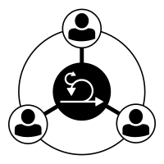





Adopting Scaled Agile Framework to this Engagement
PROGRAM INITIATIVES
Adopting *Scaled Agile Framework
<Continuous Agile Execution>
1
2
3
Business Stakeholders
Program Objectives
Release on-demand
<Key Phases>
PROJECTS
Plan
Execute
Review
Retro
Agile Scrum Teams
User Stories
Iterate,
release features
Backlog
<Communication Cadence>
<Continuous Delivery Pipeline>
TEAM COORDINATION
Agile Release Train
Dev Team
Product Owner
CI
CD
CT
Scrum Master
iterative
Notes:
Appendix

Slide 89

Adopting DevOps Best Practices to this Engagement
Development Cycle
Execution Cycle
Train & Build
Model validation
Requirements
Data Ingestion
Data Pipeline
Setup
Data Prep
Model Registry
Serving
Monitoring
Governance
Model Deployment
KPI validation
Kickoff
Feedback Loop
Notes:
Appendix

Slide 90





Illustrative: Role based assessment within each functional units
Wholesale Banking
Retail Banking
Islamic Banking
Digital Banking
ILLUSTRATIVE
Banking SME
Banking SME
Banking SME
Banking SME
Accessing Data Sources
Analytics ready DWH
Reports automation
Accessing Data Sources
Analytics ready DWH
Creating reports
Accessing Data Sources
Analytics ready DWH
Reports automation
Advanced analytics
Accessing Data Sources
Analytics ready DWH
Reports automation
Advanced analytics
P1
P1
P1
P1
P1
P1
P1
P1
P2
P3
P3
Data Scientist
Data Scientist
Data Scientist
Data Scientist
Identifying data sources
Data profiling
Data modeling
Identifying data sources
Data modeling
Identifying data sources
Data profiling
Data preprocessing
Data modeling
Identifying data sources
Data profiling
Data modeling
P1
P1
P1
P1
P3
P1
P1
P1
P3
P3
P1
Data Engineer
Data Engineer
Data Engineer
Data Engineer
Accessing Data sources
Data cleaning
Accessing Data sources
Data cleaning
Building Data warehouse
Accessing Data sources
Data cleaning
P1
Accessing Data sources
Data cleaning
Building Data warehouse
P1
P1
P1
P1
P1
P1
P1
P3
P3
Exists Already
Required, but not present
Top priority
Medium priority
Low priority
P1
P2
P3

Slide 91

BI Maturity Assessment Report
*
ILLUSTRATIVE
Key Dimensions
Areas Covered
Assessment Score (out of 20)
Client Stage
Organization
Leadership
Culture
Strategy & Skills
12
Early Adoption
Data Management
Kinds of Data
Integration
Data Quality
10.5
Early Adoption
Analytics
Reporting
Self-service Capability
Advanced Analytics
10.25
Early Adoption
Technology Infrastructure
Architecture
Technology
Project Execution
10
Pre-Adoption
Governance
Policies
Stewardship
Compliance & Security
9.75
Pre-Adoption
*BI Maturity Assessment – Adapted from TDWI

Slide 92
Cost Intelligence - Risk vs Impact
Low Business Impact
Can’t/Don’t
Could/Should
ILLUSTRATIVE
Action 1
Action 4
Could/Should
Can/Must
Action 3
High Business Impact
Action 5
Action 2
Low Risk Exposure
High Risk Exposure

Slide 93









Our suite of offerings are tailored to client context and needs
Services
BFSI
CPG
Media & Entertainment
Retail & E-commerce
Technology
Automotive
Consulting
Analytics Core
Data engineering
Visualization
Business analysis
AI/ML
Service Lines
Marketing
Analytics
Customer
Analytics
Supply
Chain analytics
Finance analytics
People
Analytics
Business Consulting
Problem Solving, IssueTrees, Approach, Story telling, Client Conversations, Strategy/Roadmaps
Products
SmartInsights
CASPER
SpotCast
MatchView

Slide 94
Easily adapt to changing client requirements through diverse experience
LatentView maintains a buffer pool of 15% comprising of analytics resources with a mix of business, technical and math backgrounds which ensures the ability to ramp up a complete team in 2 weeks
Right mix of people with Business, Technical and Math Education
Ideal distribution of work experience in the talent pool
Data Analysis & Reporting
Data Visualization
Data Engineering
Cloud Expertise
Data Science
60%
50%
40%
40%
50%

